Slide 1
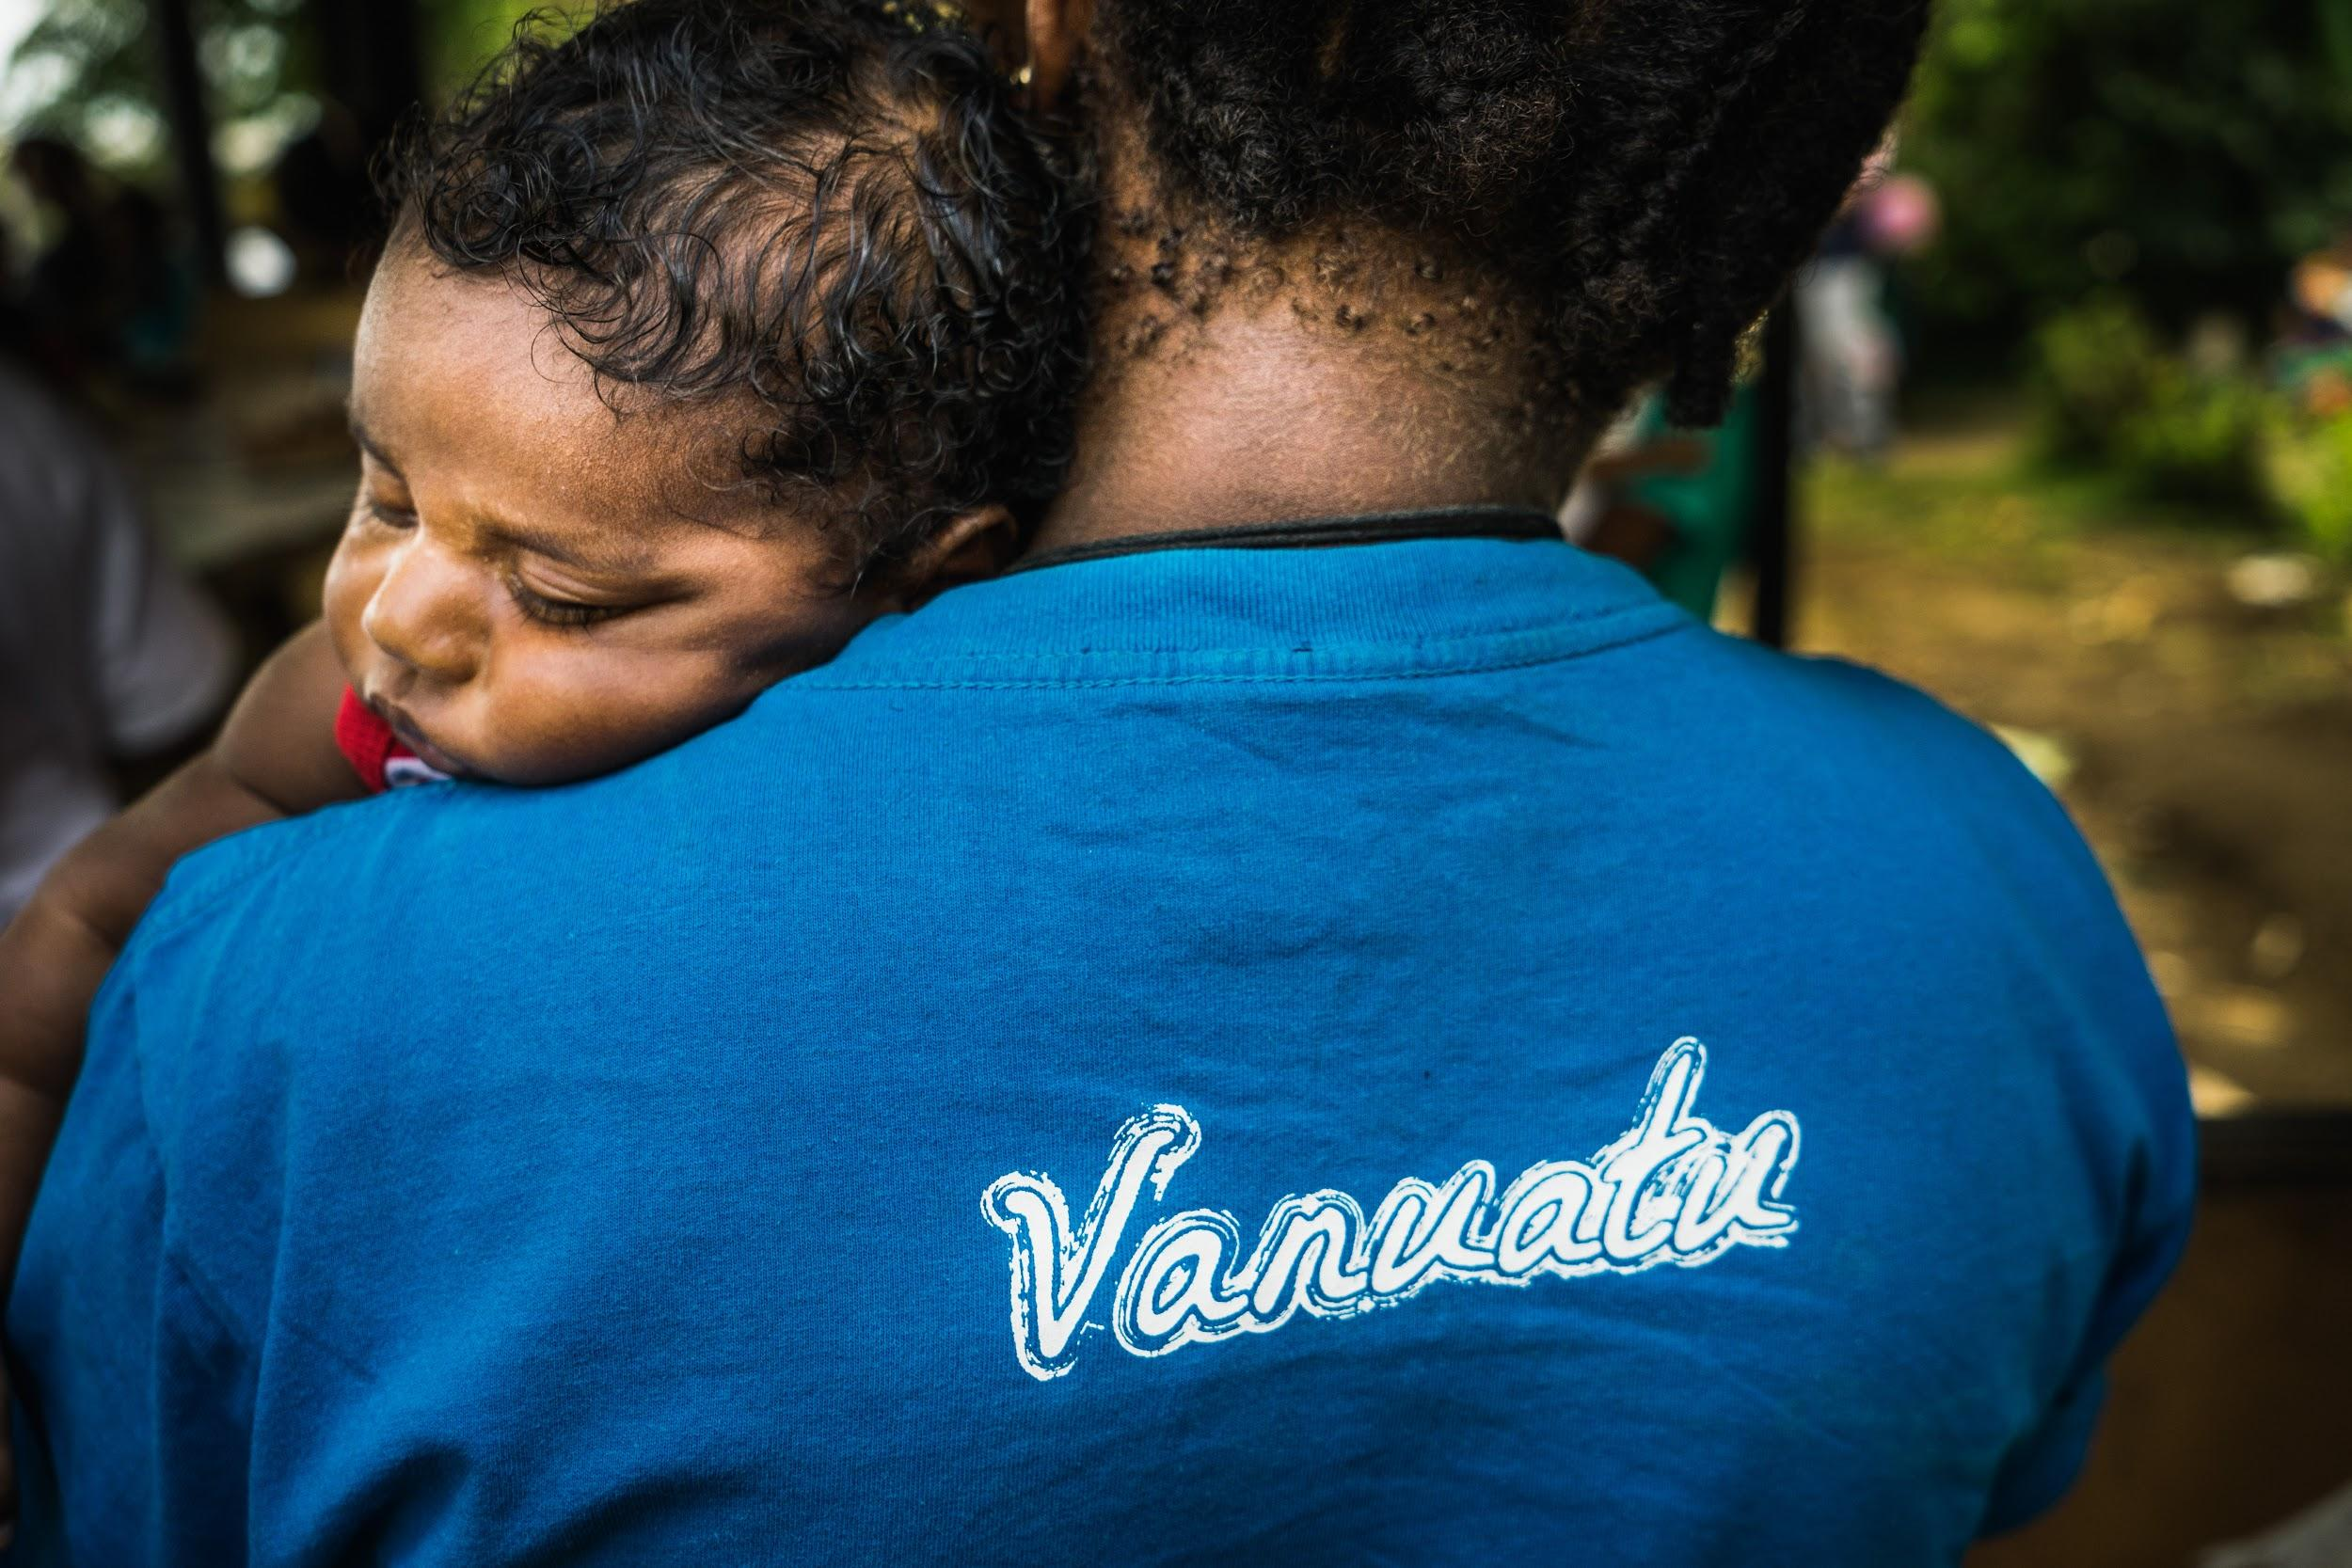
Findings from the 2018 Malaria Programme Review - and subsequent progress
Len Tarivonda, Director of Public Health
Ministry of Health
Port Vila, Vanuatu

Slide 2

Malaria Programme Review (MPR) – July 2018
Previous MPR: 2013
Current MPR conducted in two parts:
    Desk review (Nov 2017) – Dr Kevin Palmer
Field review (July 2018) – Dr Kevin Palmer, Dr Lasse Vestergaard
MPR objectives
      review epidemiology of malaria
      review structure, organization, and management (policy and program)
      assess progress towards targets
      review programme performance by intervention thematic areas and service delivery levels
      define next steps for improvement (program and strategy)

Slide 3
Vanuatu situation
Population:
~ 270,000
Population at risk of malaria:
100%
Parasites:
Plasmodium vivax (92%)
Plasmodium falciparum (8%)
Vector:
Anopheles farauti
Most disaster prone country in the world:
tropical cyclones
volcanic eruptions earthquakes
tsunamis

Slide 4
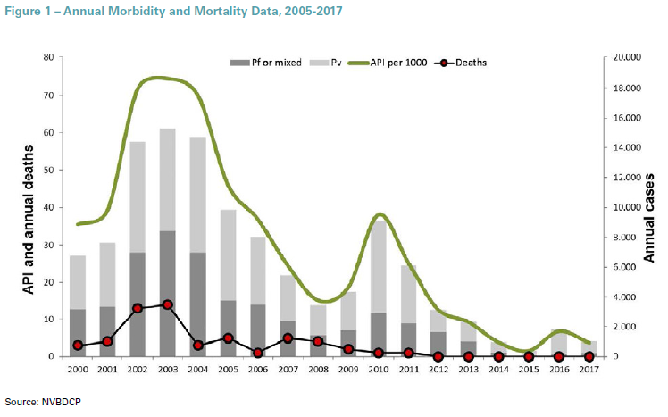
Malaria trends
Major reductions in the annual parasite rate (API = confirmed cases per 1000 population
No confirmed malaria deaths since 2012
For 2017:
- No local cases in Tafea and Torba
- 96% of cases from Malampa + Sanma
Tropical Cyclone Pam (March) caused severe damage nationwide
Upsurge in 2015 due to “failure to deliver interventions”, especially in Malampa & Sanma.
Notes:
During Tropical Cyclone Pam, 90% of buildings were damaged and the health system was heavily impacted. Malaria program activities were affected, including surveillance, prevention and case management. )

Slide 5
MPR conclusions
Vanuatu is well on its way to achieving malaria elimination
Hotspots in Malampa and Sanma must be addressed with priority
Tafea presents an operational model that can be rolled out to other provinces
Administrative and health systems issues need to be resolved ie. planning, fund availability, supervision, test + drug supplies
Human resources need to be increased, especially for surveillance/response in provinces
Decreasing funding is a concern and may undermine elimination efforts

Slide 6
MPR key recommendations & action taken (1)
1 | Address hotspots in Malampa and Sanma (new nets, supervisory visits) | 2019 LLIN distributions focussed in these areas. M&E conducted afterwards (Global Fund support)
2 | High quality, high coverage IRS to be implemented in Malampa and Sanma | Not yet commenced – partner support needed.
3 | LLIN operational planning based on household census | Nationwide LLIN survey to be conducted Q1/2020 (WHO support)
4 | Streamlined financial system to facilitate field level operations | Under discussion. MOH Project Management Unit to be established.
5 | Fund available that can be rapidly drawn on for outbreaks/imported cases | Under discussion. MOH Project Management Unit to be established.
LLIN: long-lasting insecticidal net; MOH: ministry of health; M&E: monitoring and evaluation; WHO: World Health Organization

Slide 7
MPR key recommendations & action taken (2)
6 | National malaria elimination plan developed | Commenced August 2019 (WHO support)
7 | National Elimination Advisory Committee established | Terms of Reference developed. To be endorsed by MOH Executive.
8 | Tafea model rolled out to all provinces (national strategy with DFAT support) | Case study currently in progress. (APLMA support)
9 | Pre-elimination surveillance implemented in Torba, Shefa and Penama | Roll-out of case-based surveillance in progress. DHIS tracker module to be piloted Q3/2019 (DFAT support)
10 | Full coverage of LLINs in Tafea | LLIN gap remains – partner support needed.
LLIN: long-lasting insecticidal net; MOH: ministry of health; M&E: monitoring and evaluation; WHO: World Health Organization;
DFAT: Australian Department of Foreign Affairs and Trade; APLMA: Asia Pacific Leaders Malaria Alliance; DHIS: district health information software

Slide 8
MPR key recommendations & action taken (3)
11 | Additional funding sought | Commenced discussions with Rotarians Against Malaria. Global Fund MEMTI grant anticipated 2021-2023
12 | Malaria Elimination Officer established in every province | Supervisor positions under recruitment. Temporary staff contracted (WHO support - 3 provinces). Additional ‘boots on ground’ critical – partner support needed. Exploring options for international volunteers.
13 | Careful monitoring of G6PD tests and availability and use of Primaquine | Assessment just completed (Global Fund support). Discussions on whether the switch to delayed treatment campaigns to prevent relapses
14 | Collaborate with Central Medical Stores to prevent stock-outs | Under recruitment (malaria program staff based in CMS). Temporary staff to be contracted (WHO support)
15 | Monitoring RDT correct use & reading plus provide training | Commenced in 2019 (Global Fund support) - one-on-one supervision and training of healthy facility staff
G6PD: glucose-6 phosphate dehydrogenase; MEMTI: Malaria Elimination in Melanesia and Timor-Leste; RDT: rapid diagnostic test

Slide 9
MPR key recommendations & action taken (4)
16 | Ensure regular supervisory visits to support peripheral health facilities | Re-commenced in 2019 (Global Fund support) - one-on-one supervision and training of health facility staff (diagnosis, treatment, surveillance)
17 | Microscopy SOPs and QA/QC plan to be put in place, with supervisory visits | Technical assistance to be provided in Q3/2019 (WHO support)
18 | Include G6PD tests and primaquine treatment in updates to national treatment guidelines | Planned for 2020
19 | Resolve stockout issues and improve supply chain management and forecasting | Under recruitment (malaria program staff based in Central Medical Store). Temporary staff to be contracted (WHO support)
20 | Enhance public support for elimination | High level political support sought (Deputy Prime Minister). Broad-scale advocacy campaign required – partner support needed.
G6PD: glucose-6 phosphate dehydrogenase; MEMTI: Malaria Elimination in Melanesia and Timor-Leste; QA/QC: quality assurance/quality control; RDT: rapid diagnostic test

Slide 10

Priorities
Significant progress made in 2019 – but further work and support needed
ADVOCACY
SUSTAINABILITY
TECHNICAL
MANAGEMENT
IMPACT
Promoting “the last push” to nationwide malaria elimination, with strong public support
Renewed/elevated commitment of development partners to reach and maintain elimination
Increased government attention and financial support
Priority actions:
Re-achieve and maintain LLIN universal coverage
Initiate IRS targeted to hotspot areas
Strengthen P. vivax case management
Urgent attention to:
Supervisory visits
Filling vacant staff positions (especially in provinces) – and augmenting with external contractors
Procurement & supply chain management
Operational & financial planning
Zero malaria transmission – by end of 2023
WHO malaria elimination certification - by end of 2026
LLIN: long-lasting insecticidal nets; IRS: indoor residual spraying

Slide 11
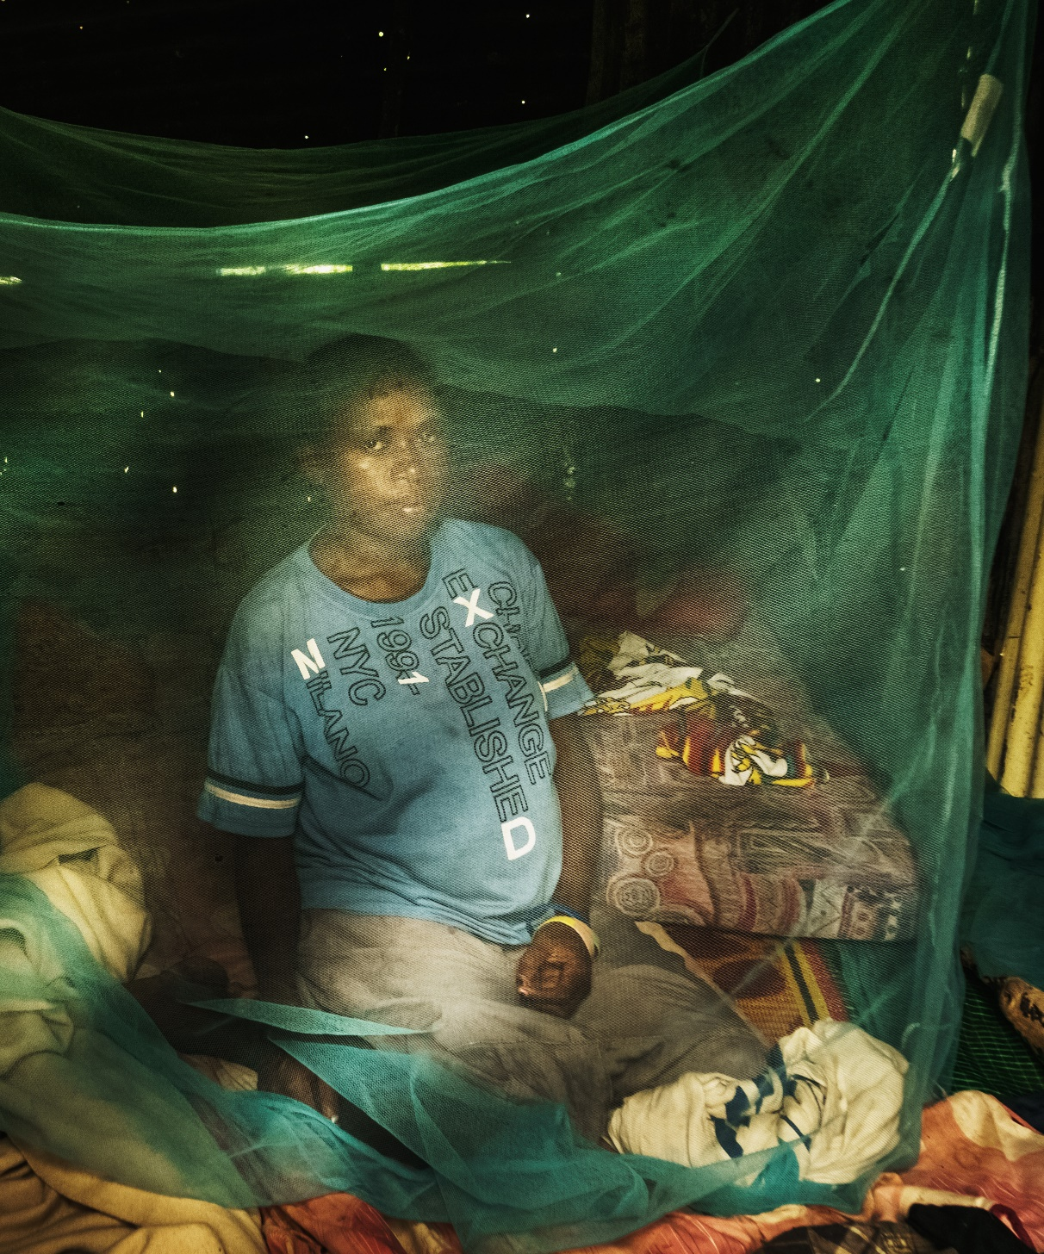
Key needs
2021 – 2023: Significant injection of funds for malaria elimination anticipated through Global Fund “MEMTI” grant (health systems strengthening)
Immediate needs (2019 – 2020)
Ramp up of activities and support required to prepare for intensified “push” to malaria elimination
  Universal coverage of mosquito nets (including in Tafea) – need support for nets, storage facilities, distributions and M&E
  Targetted indoor residual spraying in hot spots – need support for insecticides, operations, M&E
  Advocacy and communications – need support to develop strategy and materials
M&E: monitoring and evaluation; MEMTI: Malaria Elimination in Melanesia and Timor-Leste

Slide 12





Acknowledgements
All people and collaborators involved at all levels
All support from international partners and donors
Thanks for your attention

