Slide 1
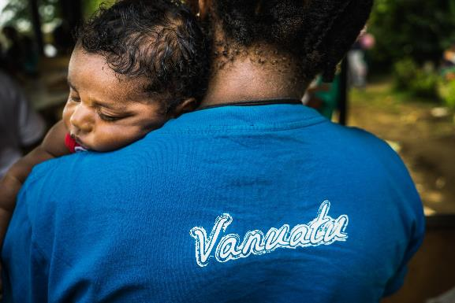
MALARIA ELIMINATION IN VANUATU: current situation, challenges and opportunities
Len Tarivonda, Director of Public Health
Ministry of Health
Port Vila, Vanuatu

Slide 2
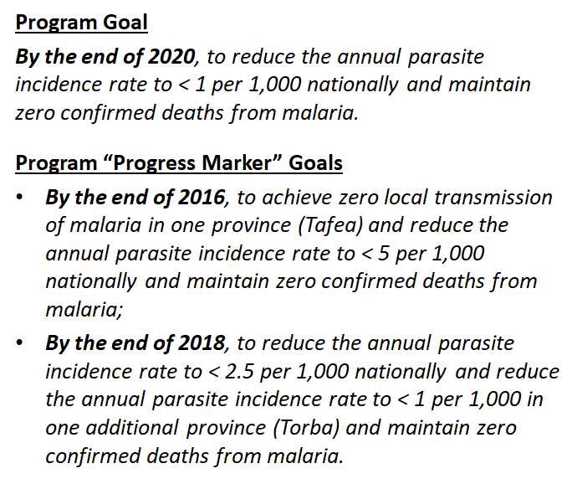
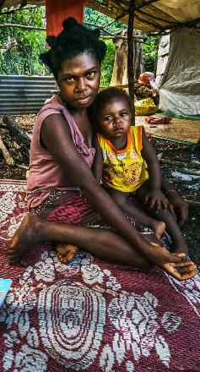
Strategic Goals for 2015-2020
On track
Achieved
Partially
achieved

Slide 3
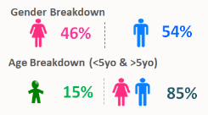
National Progress
Last death reported in 2012
Parasite species (%)
Pv Pf
2015 66 34
2016 95 5
2017 74 26
2018 92 8
Pv = Plasmodium vivax;
Pf = Plasmodium falciparum

Slide 4
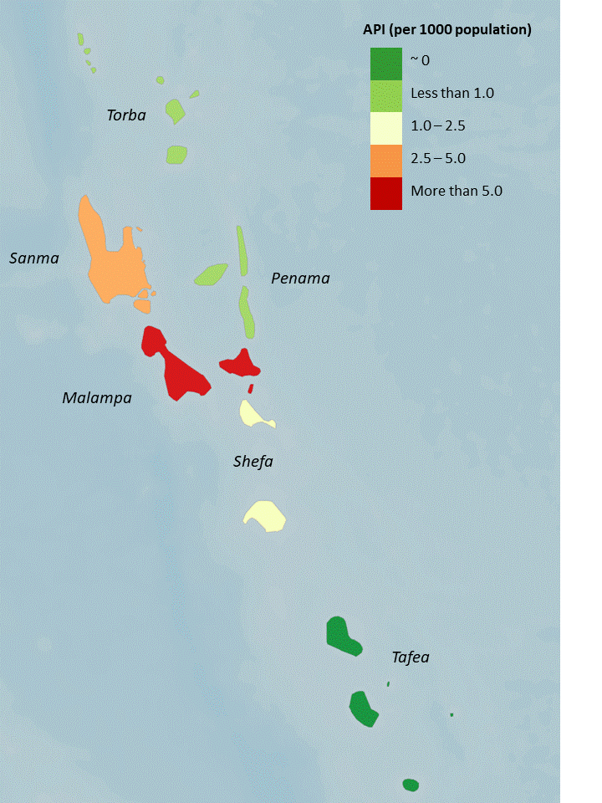
Provincial Progress
API, 2018
Annual parasite incidence (API), 2015 – 2018
Province | 2015 | 2016 | 2017 | 2018
Malampa | 2.8 | 24.3 | 10.7 | 5.1
Sanma | 3.8 | 15.7 | 10.7 | 3.8
Shefa | 0.2 | 0.4 | 0.18 | 1.7
Torba | 2.4 | 0.7 | 0 | 0.72
Penama | 2.2 | 0.6 | 0.78 | 0.17
Tafea | 0.0 | 0.0 | 0.03 | 0.08
Vanuatu | 1.6 | 6.8 | 3.8 | 2.2
Sanma & Malampa provinces accounted for 65% of all cases reported in 2018

Slide 5
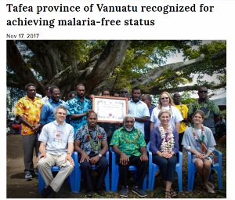
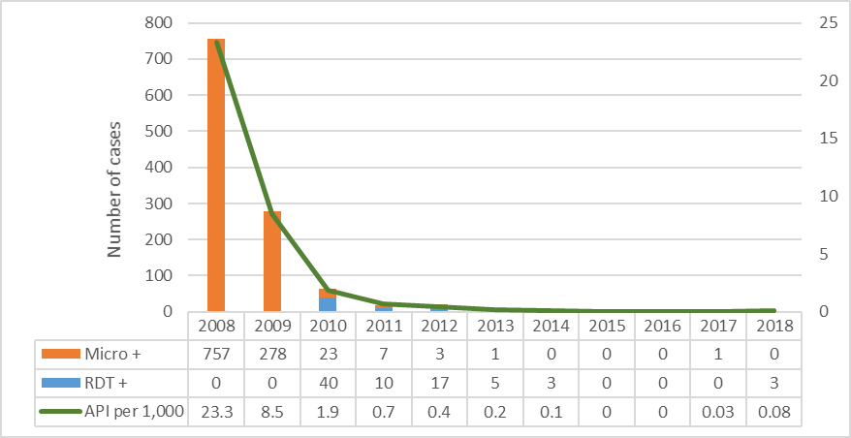
Sub-national Elimination Progress
Since 2008, dedicated malaria elimination efforts in Tafea province:
100% coverage of all malaria interventions
Improved surveillance, case finding and case investigation
Strong provincial & community engagement
Additional staff (Malaria Elimination Officers)
Strong attention to program management, M&E, reporting
Made possible by significant funding from donors
Technical support from WHO and academia
No locally acquired cases in Tafea since 2014
Sub-national malaria-free status declared in Tafea province in Nov 2017

Slide 6
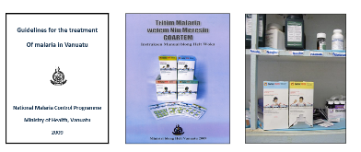
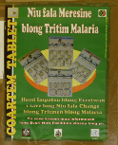
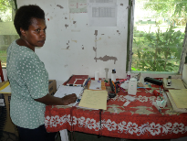
National Progress – Malaria Diagnosis and Treatment
In 2009, major shift in malaria treatment policy
Malaria rapid diagnostic tests (RDTs) & Artemesinin Combination Therapy (ACTs) introduced to all health facilities
Helped to reduce malaria transmission and morbidity
Relapsing cases of vivax-malaria a major obstacle
Primaquine used but ensuring safe and effective use is very difficult in Vanuatu
However, cases continue to fall and elimination has been achieved in Tafea Province and other islands despite limited use of primaquine

Slide 7
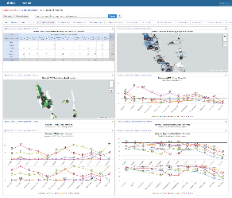
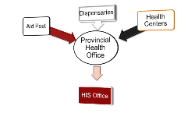
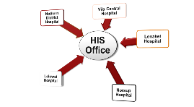
National Progress – Surveillance and Case-Based Tracking
Malaria information system integrated into national health information systems (DHIS2)
Case investigations, reactive case-detection and response currently being rolled out to all provinces (DHIS2 tracker pilot in progress)
Surveillance given strong priority - including in elimination areas to detect any resurgence
Strong emphasis on M&E and programme management has guided all control and elimination activities
M&E: monitoring and evaluation

Slide 8
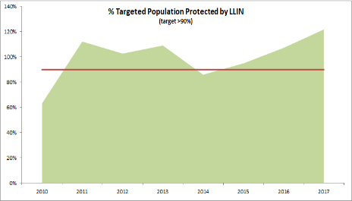
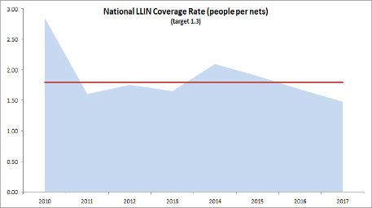
National Progress - Vector Control
From 2010 – 2016:
Long-lasting insecticide net (LLIN) distribution strategy of universal coverage
Over 600,000 LLINs distributed
High LLIN coverage levels
Relatively high LLIN usage (68.9%)
Volcano response
Since 2017:
LLIN distribution strategy shifted to targeted coverage due to limited resources - risky
BUT no full LLIN survey since 2013 – planned for Q1/2020

Slide 9
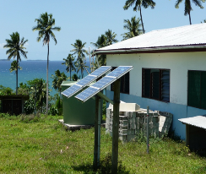
Challenges/Opportunities - evolving health sector
Government, MOH & donor priorities are now focused more on health system strengthening.
Includes more integrated approaches to:
Public health policy
Financial & operational planning
Workforce development at all levels
New role delineation policy clearly defines roles of health staff at all levels
Disease surveillance & disease control
Traditionally “verticalized” disease programs must adapt to fit this new model

Slide 10
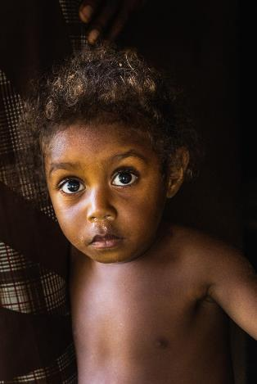
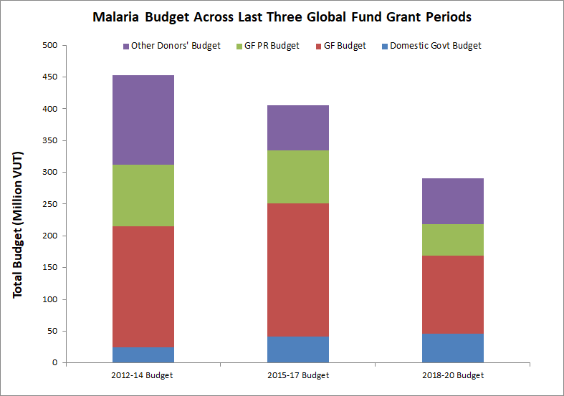
Challenges/Opportunities – decreased funds 2018-2020
Govt. spending stable
Current Global Fund allocation reduced from $2.7M USD to $1.6M
Australian Government (DFAT) funding has reduced
Very difficult to progress elimination agenda with decreasing investment

Slide 11
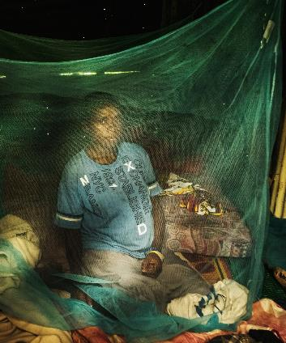
Challenges/Opportunities – additional support expected
2019 - 2020
Potential to access additional domestic funds
WHO support provided as staffing stop-gap (3 provincial, 3 national staff)
Renewed interest by development partners
Rotarians Against Malaria
Australian Government
Exploring options to access community-based volunteers (ie. through international dev programs)
2021 - 2023
Potential significant injection of funds through MEMTI grant (Global Fund, World Bank etc.) - mainly for health systems strengthening

Slide 12
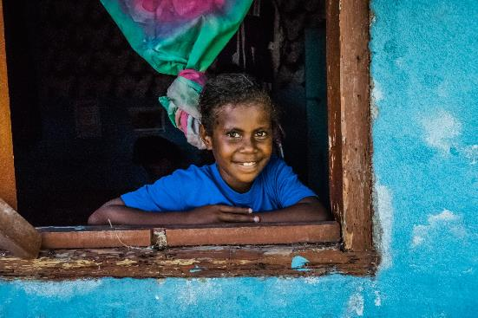
Challenges/Opportunities – additional support expected
AMBITIOUS NEW GOALS considered for 2021-2025 strategy:
By the end of 2023, to achieve zero indigenous transmission of malaria
By the end of 2026, to attain WHO malaria elimination certification

Slide 13
Key needs to enable elimination
Significant progress made in 2019 – but further work and support needed
ADVOCACY
SUSTAINABILITY
TECHNICAL
MANAGEMENT
IMPACT
Promoting “the last push” to nationwide malaria elimination, with strong public support
Case study on Tafea elimination program to document lessons learned for adaptation elsewhere
Renewed/elevated commitment of development partners to reach and maintain elimination
Increased government attention and financial support
Priority actions:
Re-achieve and maintain LLIN universal coverage
Initiate IRS targeted to hotspot areas
Strengthen P. vivax case management
Urgent attention to:
Supervisory visits
Filling vacant staff positions (especially in provinces) – and augmenting with external contractors
Procurement & supply chain management
Operational & financial planning
Zero malaria transmission – by end of 2023
WHO malaria elimination certification - by end of 2026
LLIN: long-lasting insecticidal nets; IRS: indoor residual spraying

Slide 14
Acknowledgements
All people and collaborators involved at all levels
All support from international partners and donors
Thanks for your attention

