Slide 1
Malaria – amazing success; huge challenges

Slide 2
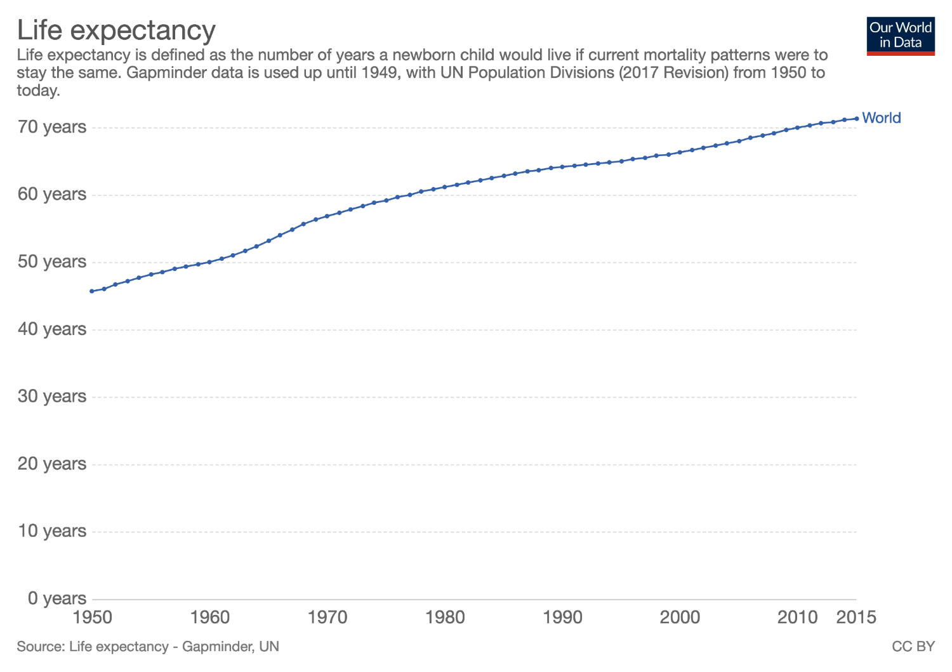
Life expectancy is up!
Life expectancy – whole world
…this is true in every region of the world, rich and poor

Slide 3
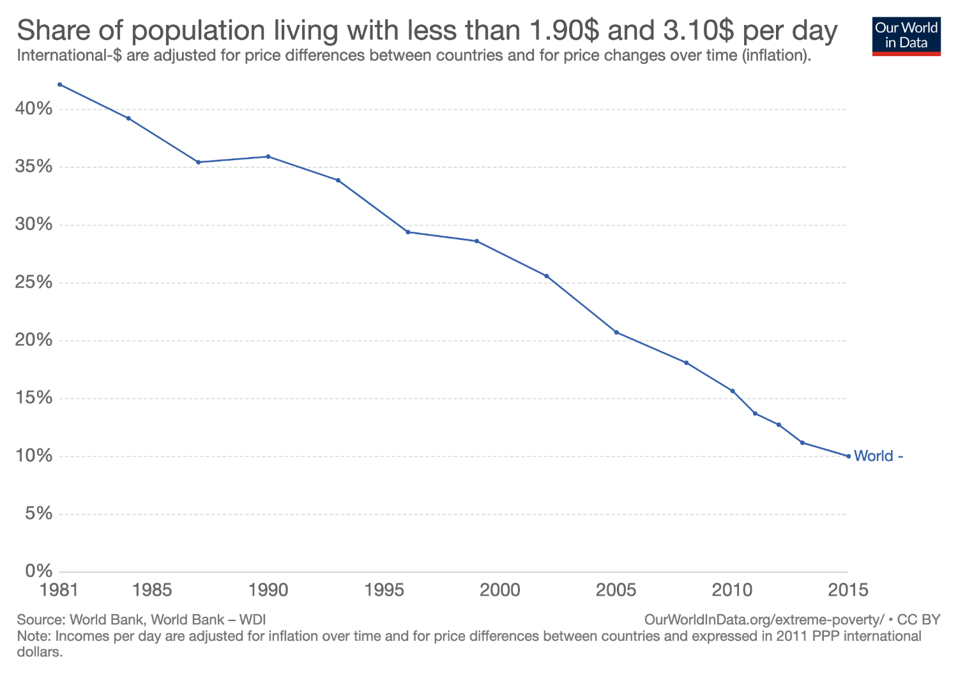
Extreme poverty is down!

Slide 4
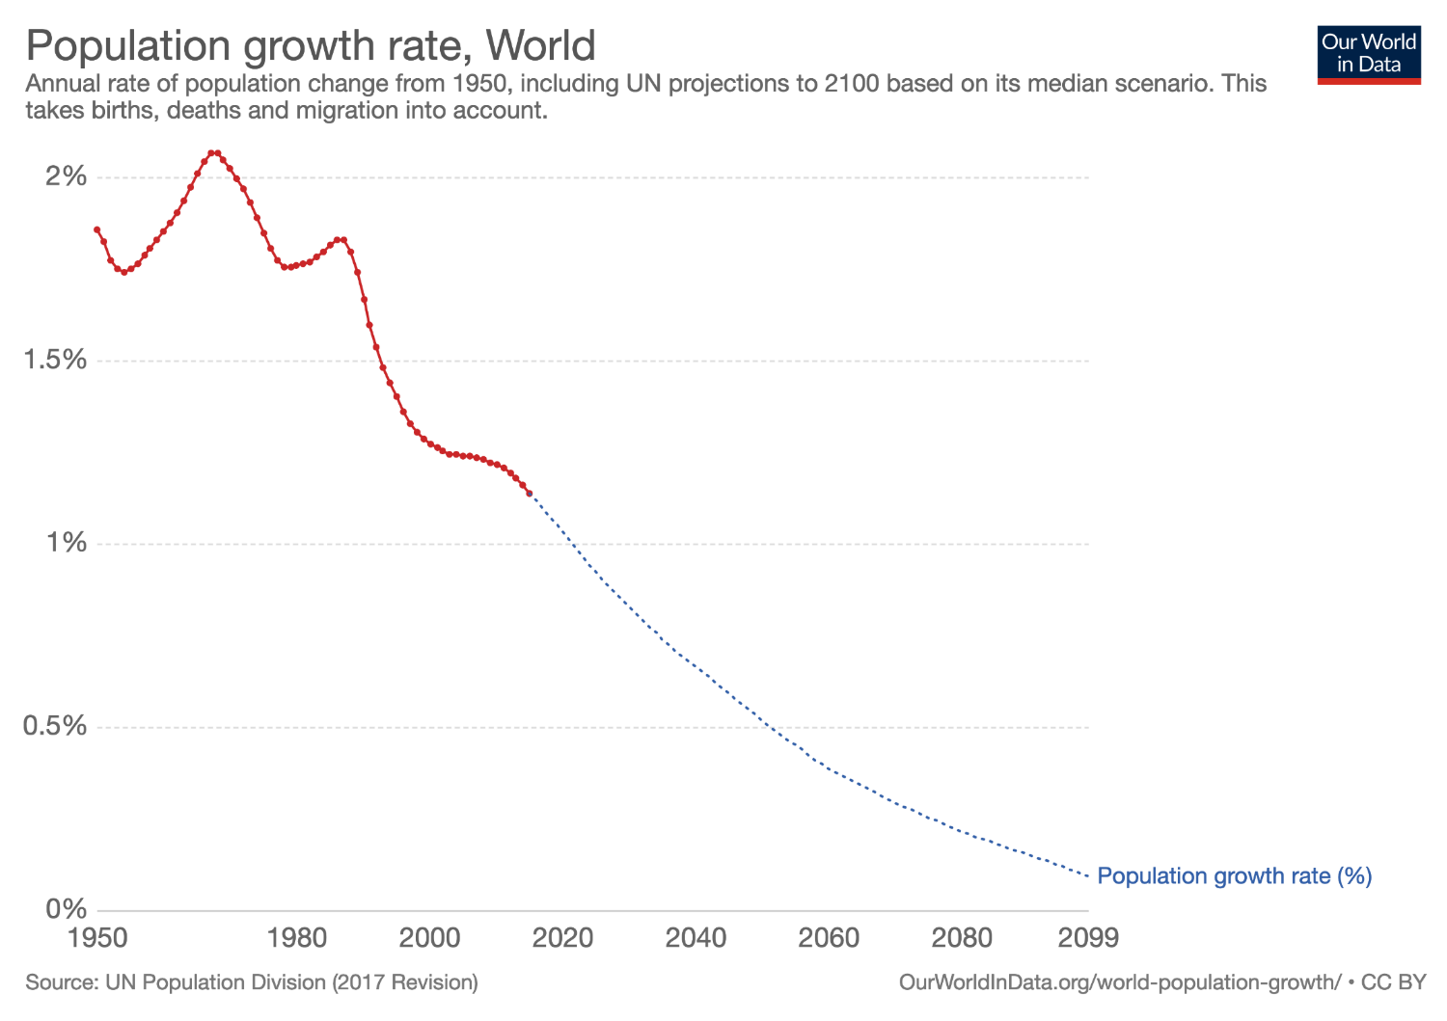
Population growth rates are in decline
…this is because fertility rates decline as parents become confident of their kids survival

Slide 5
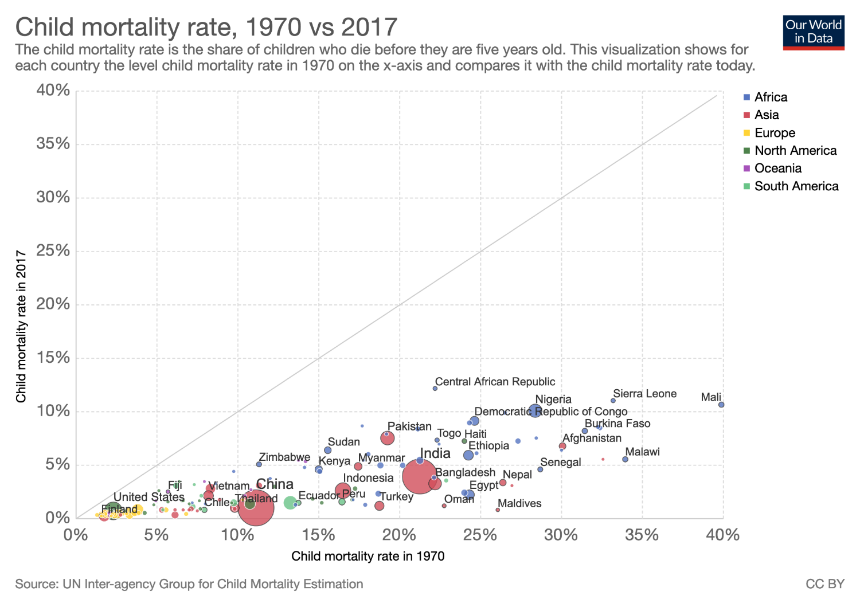
Gains in child survival are across the board

Slide 6
Beating infectious disease in children: malaria is hard!

Slide 7
Beating malaria in the tropics is especially hard

Slide 8
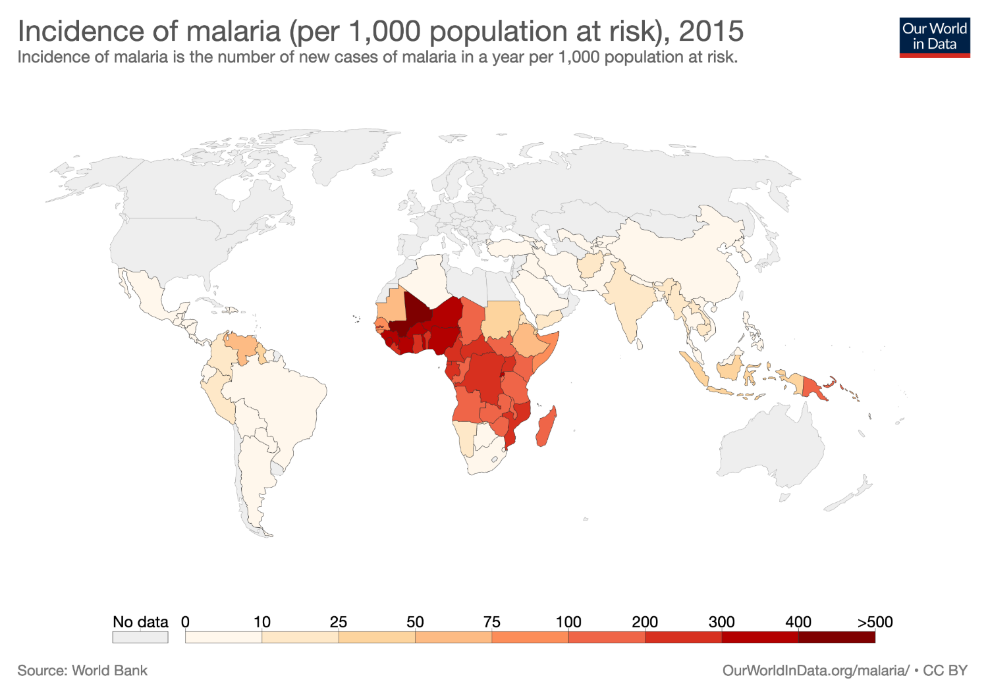

Slide 9
Malaria cases by region in 2017 (millions)
World malaria report 2018

Slide 10
Huge success: Since 2010…
~1 million lives saved (607,000 to 435,000 deaths/annum)
~100 million cases averted (239 million to 219 million cases/annum)
Several countries have eliminated malaria
World malaria report 2018

Slide 11
An update on elimination

Slide 12
Malaria in 2018
Cape Verde
El Salvador
São Tomé &
Príncipe
Maldives
Zanzibar
Seychelles
Solomon Islands
Comoros
Mayotte
Timor-Leste
Mauritius
Vanuatu
Reunion
Malaria-free (≥ 3 years) Malaria-free (< 3 years)
Eliminating malaria Controlling malaria

Slide 13
Why the success? – Better testing and treatment

Slide 14
Why the success? Better prevention

Slide 15
But, progress has stalled
World malaria report 2018

Slide 16
Resurgence in PNG
World Malaria Report 2017

Slide 17
Why the stalling? Darwinism
Hard to know precisely but includes some technical issues…
Insecticide resistance
Drug resistance
Diagnostic test ‘resistance’

Slide 18
Pyrethroid resistance frequency

Slide 19
What else is/will impede further progress…
Financing challenges
Have we reached the limits of what’s possible in the ‘hardest’ areas?
Shifts in climate, populations and vector location
Distraction through complacency, conflict, other priorities, etc

Slide 20
Resourcing

Slide 21
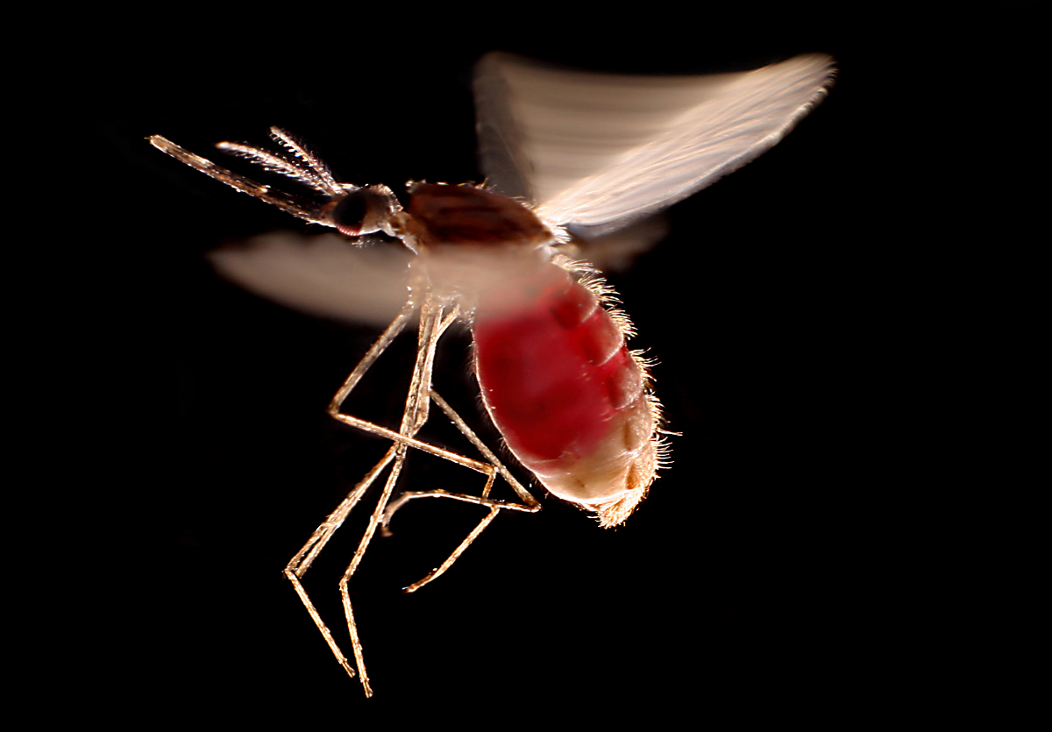

Alarming spread of Anopheles stephensi
Djibouti City,
Djibouti
Mannar District,
Sri Lanka
Jaffna District,
Sri Lanka
Kebri Dahar,
Ethiopia
Photo: Dr. Hugh Sturrock

Slide 22
What can be done about it
High Burden to High Impact strategy; a targeted malaria response
Integrate research, data and innovation into all facets of the response; that is, develop and use the latest tools and knowledge; always learn in a robust way

Slide 23
High Burden to High Impact strategy
The Global Technical Strategy for Malaria 2016–2030 calls for
reducing malaria cases and deaths by at least 40% by 2020, at least 75% by 2025 and at least 90% by 2030.
Without a major turnaround, these targets are unlikely to be met – a challenge further compounded by insufficient levels of funding for malaria control.
”High burden to high impact” is a country-led response – catalyzed by WHO and the RBM Partnership – to reignite the pace of progress in the global malaria fight.

Slide 24
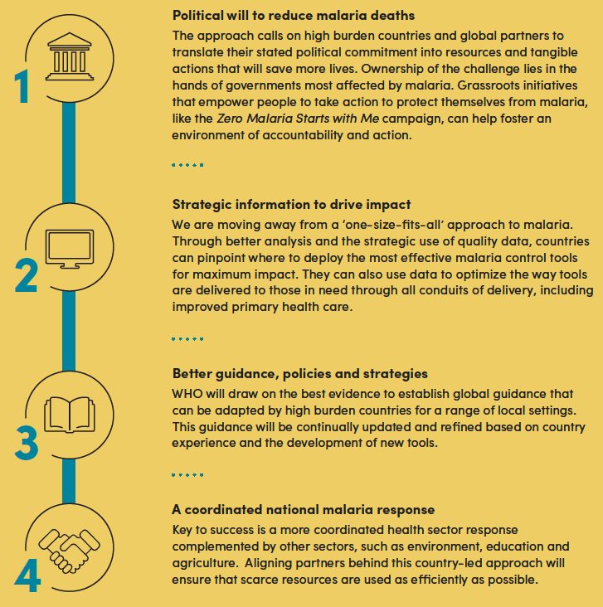

Slide 25
