Slide 1
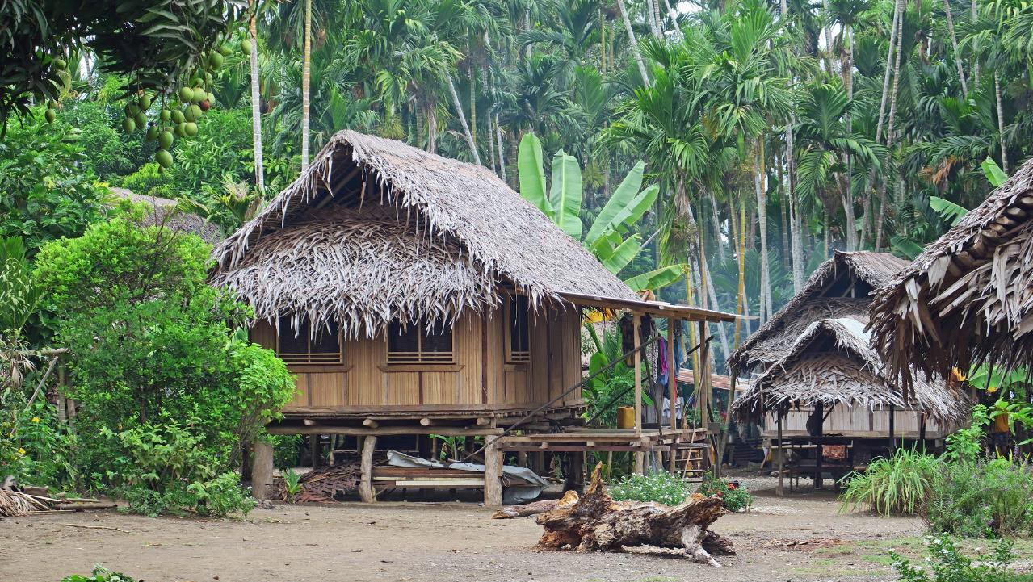

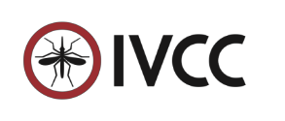
Creating and delivering a toolbox of disruptive vector control innovations for malaria eradication….
….ahead of time, on budget and with high impact
IVCC Indo-Pacific Initiative Nick Hamon PhD
Rotarians for Malaria 13th Sept. 2020
1
Building Partnerships • Creating Solutions • Saving Lives

Slide 2

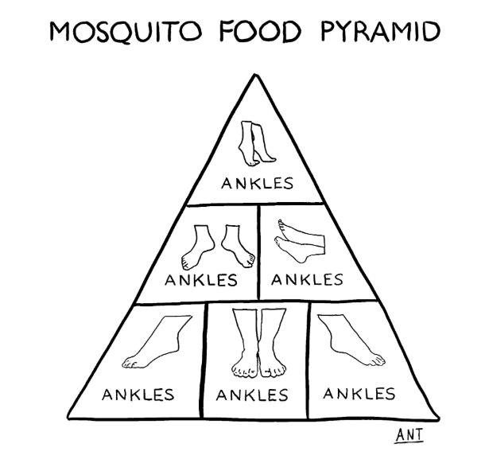

The impact of mosquitoes to some….simply a nuisance….
A 4-year delay in implementing next- generation ITNs would result in more than 83 million* additional malaria cases over the course of 2023 to 2040 and an additional 166,000 – 277,000 lives lost
This 83 million is the difference between,
  the cases averted by introducing next-generation ITNs in 2023 at increasingly higher cover relative to using PBO ITNs at 2016 cover
  and, the cases averted by introducing next- generation ITNs in 2027 whilst upping PBOs to increasingly higher cover in the interim , relative to using PBO ITNs at 2016 cover
Anthony Martignetti, September 2020
2
Building Partnerships • Creating Solutions • Saving Lives

Slide 3


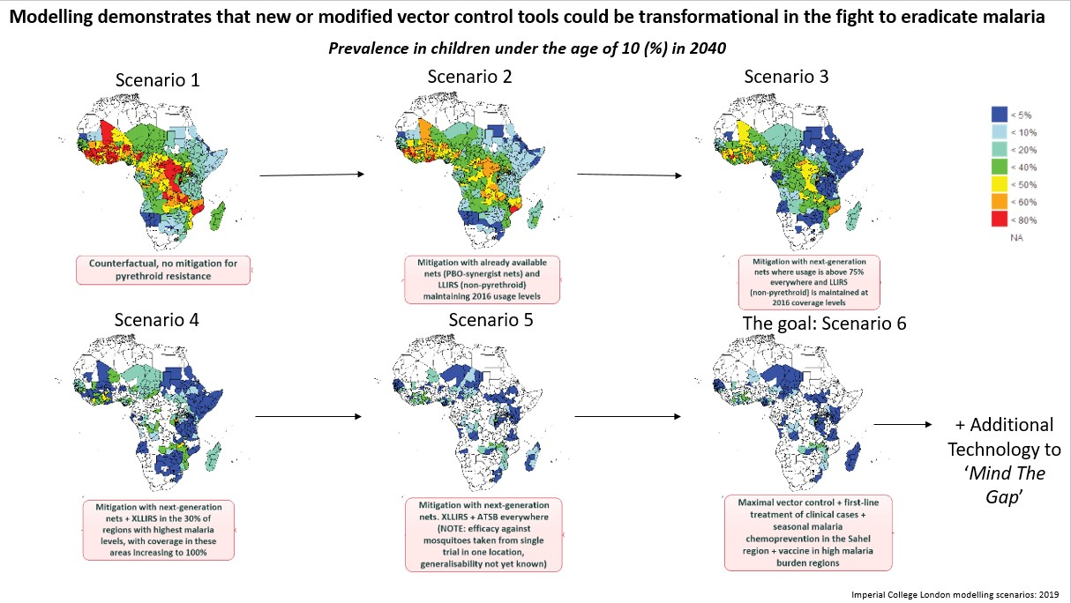
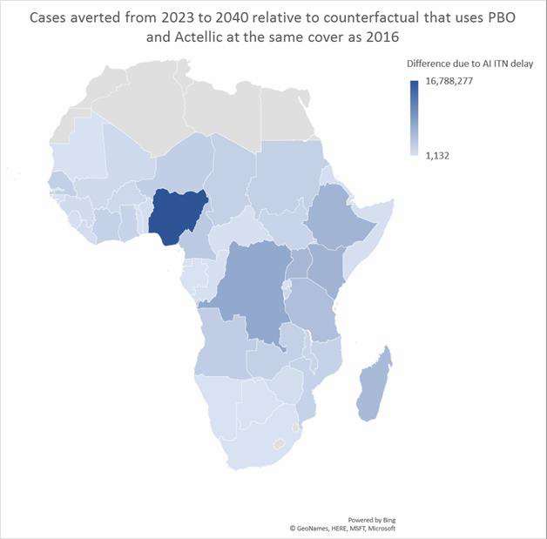
Modelling has given us an idea of the human cost of delayed development
Ellie Sherrard-Smith and Tom Churcher, IC (13th December 2019)
Cases averted for each iterative intervention impact compared to counterfactual 2 where:
drugs are administered as 2016
ITN cover is continued as 2016
ITNs are switched to PBOs from 2016 with resistance arriving in 20% increments up to 80% resistance by 2022
Actellic IRS is implemented from 2016 and at 2016 levels of cover
No ATSB is used
SMC is used at 2016 levels
No vaccine is implemented
3
Building Partnerships • Creating Solutions • Saving Lives

Slide 4


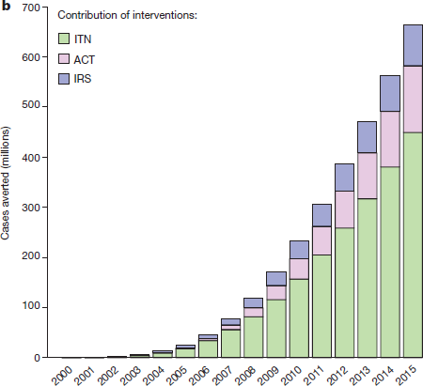
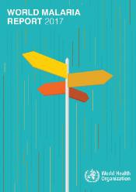
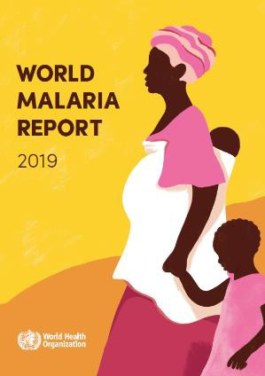



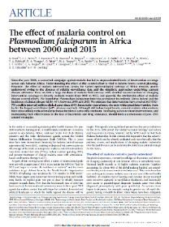
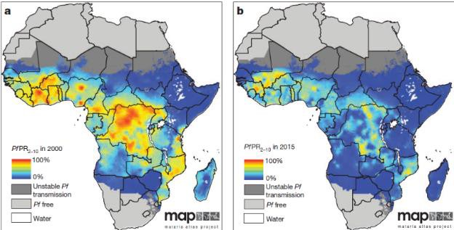
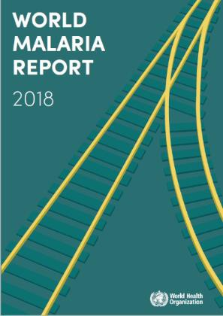
Long Lasting Insecticide Treated Nets and Indoor Residual Spraying
account for much of the malaria burden reductions achieved since 2000
IRS ACT
ITN
Shrinking Malaria Map
2000 – 2015
Malaria deaths globally fell from 839,000 in 2000 to an estimated
446,000 in 2016.
The WHO African Region accounted for 91% of all malaria deaths in 2016, followed by the WHO South East Asia Region (6%)
‘Progress appeared to have stalled’.
10 highest burden African countries saw an estimated 3.5 million more malaria cases in 2017 compared with the previous year. Malaria continues to claim the lives of more than 435,000 people each year.
Malaria Atlas Project
663 million clinical cases of malaria averted
68% of malaria cases
averted by ITN
11% of malaria cases
averted by IRS
2000 -
2015
Building Partnerships • Creating Solutions • Saving Lives

Slide 5

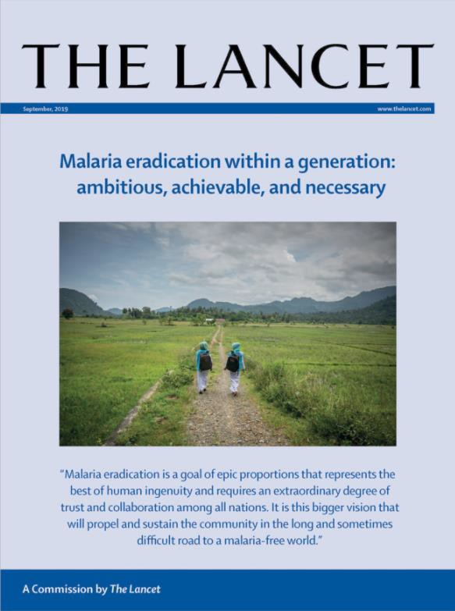
Lancet Commission on Malaria Eradication:
September 2019
Eradication by 2050 achievable and necessary
Insecticide-based vector-control tools have saved more lives than any other set of interventions and will be essential for eradication.
….calls for substantial investment in new diagnostics, drugs,
and vector control
Insecticide resistance must be addressed
‘IVCC oversees the pipeline in this area, and we describe prospects for addressing these challenges’ New insecticides with novel mechanisms of action are essential.
  2017/2018 marked the release of the first new insecticides for malaria in more than 30 years. Clothianidin (IRS), chlorfenapyr (dual-ingredient LLIN).
  Three candidate insecticides with novel modes of action
are under development.
5
Building Partnerships • Creating Solutions • Saving Lives

Slide 6
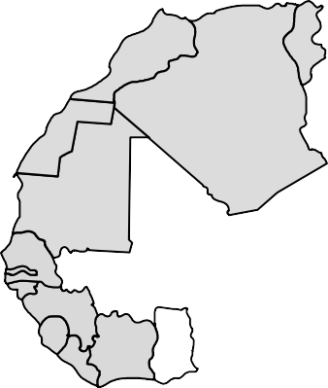
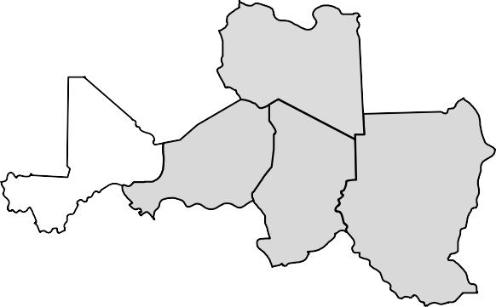

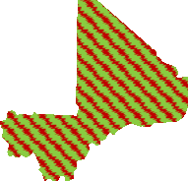
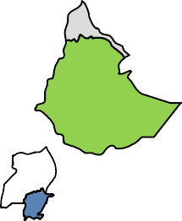

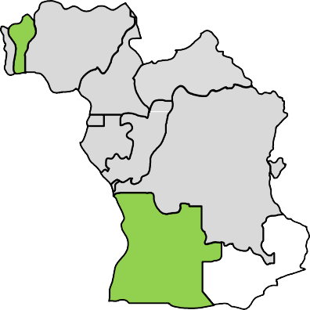




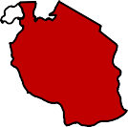


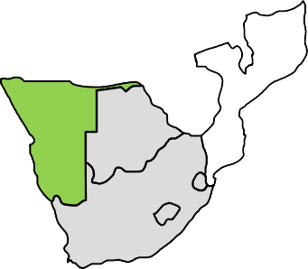



NgenIRS Project
New Technology Demonstrates Public Health Impact in Africa
135 million people protected
10 of 16 NgenIRS partner countries sprayed multiple 3GIRS products in 2019
Estimated number of people protected
throughout Africa by IRS programmes receiving NgenIRS support (2016-2019)
22% - 47%
drop in cases
Reduction in confirmed cases recorded in the public health system where NgenIRS impact data were collected, compared to similar regions without IRS
5.6 million - 11.2 million cases averted
Estimated number of cases averted by NgenIRS supported IRS campaigns (2016 – 2019)
Actellic® 300CS SumiShield® 50WG Fludora® Fusion
16,586 and 33,173
lives saved
Estimated number of lives saved by NgenIRS supported IRS campaigns (2016 – 2019)
Building Partnerships • Creating Solutions • Saving Lives

Slide 7
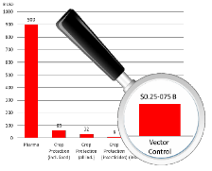




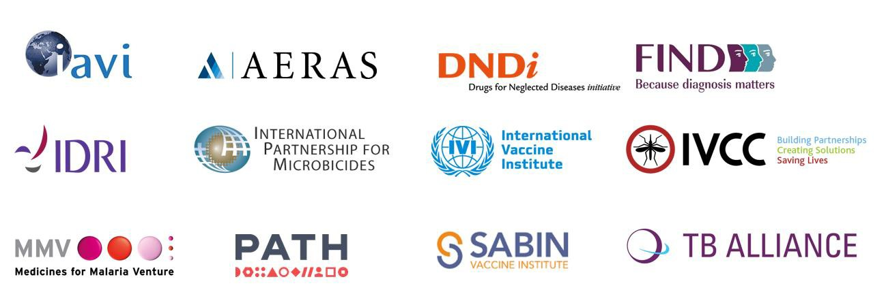




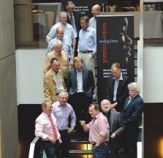
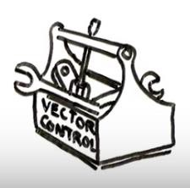













IVCC: A Product Development Partnership (PDP) for Vector Control
IVCC is a PDP investing donor funds in R&D to
overcome barriers to innovation in vector control.
We facilita
Addressing
De-risking
ation
te the development and delivery of market innov
improved vector control tools and challenges
n challenged markets to combat the
ing problem of insecticide resistance.
05 at the Liverpool School of Tropical ^{Tech}
Medicine Innovator proje
community prod
expert mana
support platf
Educa
novel and solutions i rapidly grow
Started in 20
nical ct and uct
gement orm
tion,
R&D
Impact
advocacy and engagement
driven
Building Partnerships • Creating Solutions • Saving Lives

Slide 9

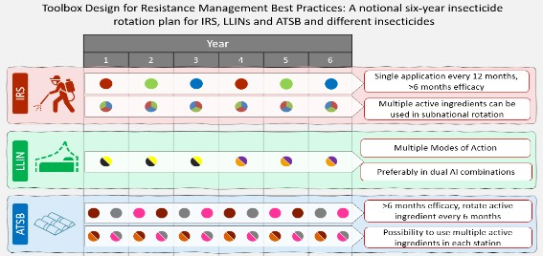

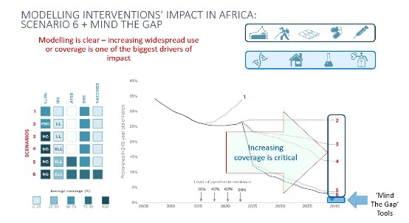

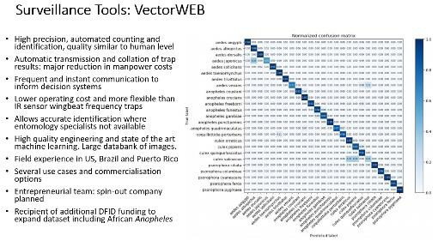

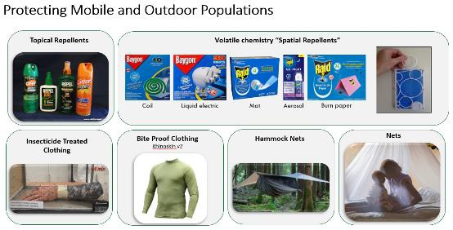
Malaria Eradication:
What Modelling, Good Science and Experience Tells Us We Need
Proven tools (LLINs and IRS) that will work against resistant mosquitoes through to eradication
Disruptive tools such as ATSB to block
outdoor transmission
Increased impact needs increased coverage (optimize costs, improve efficacy)
Universal coverage is not feasible: Data driven decision making supported by surveillance tools are essential
Last mile’ innovations needed to protect mobile populations (personal protection, forest packs……) and tools for vulnerable urban settings (An. stephensi)
9
IVCC Business Confidential
Building Partnerships • Creating Solutions • Saving Lives

Slide 10

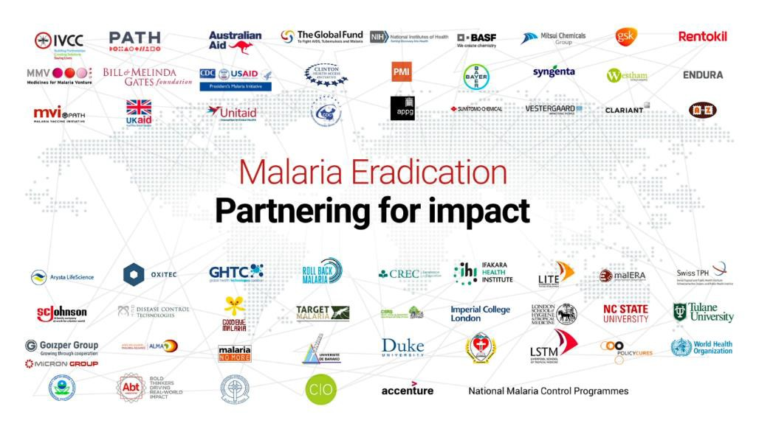
Malaria Eradication:
What Modelling, Good Science and Experience Tells Us We Need
Proven tools (LLINs and IRS) that will work against resistant mosquitoes through to eradication
Disruptive tools such as ATSB to block
outdoor transmission
Increased impact needs increased
coverage (optimize costs, improve efficacy)
Universal coverage is not feasible: Data driven decision making supported by surveillance tools are essential
Last mile’ innovations needed to protect mobile populations (personal protection, forest packs……) and tools for vulnerable urban settings (An. stephensi)
Collaboration of all stakeholders in the delivery of interventions….funders, implementers, WHO, industry, NMCPs, ALMA, APLMA, countries….
10
IVCC Business Confidential
Building Partnerships • Creating Solutions • Saving Lives

Slide 11



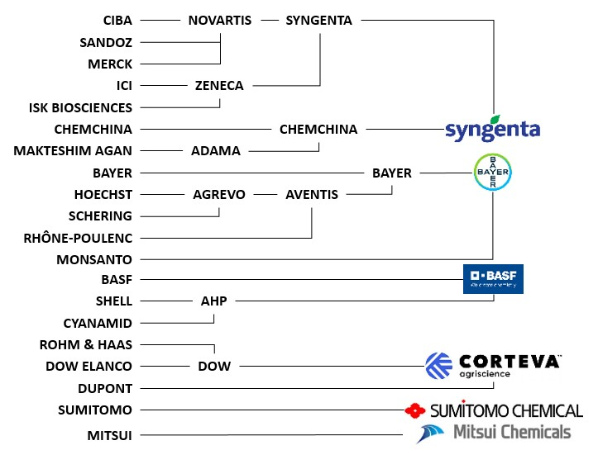
Vector Control Innovation and Agriculture
Innovation, product development and market access historically comes from the agrochemical industry as repurposed insecticides
Rapid consolidation of insecticide R&D based manufacturer…..from 20 to 6 in less than 25 years
Building Partnerships • Creating Solutions • Saving Lives

Slide 12


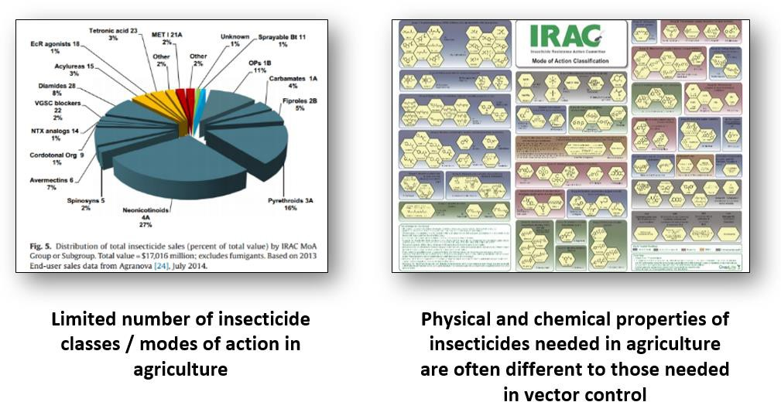
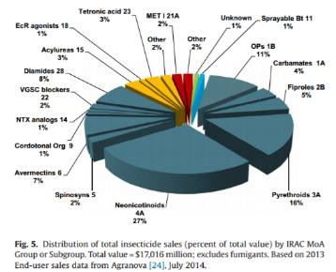
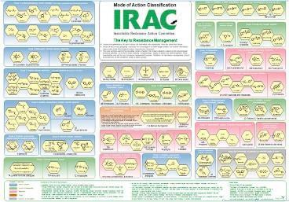
The Pipeline of Existing Chemistry for Repurposing is Drying Up
IVCC Business Confidential: PLEASE DO NOT SHARE WITH NON-RECIPIENTS
Building Partnerships • Creating Solutions • Saving Lives

Slide 13


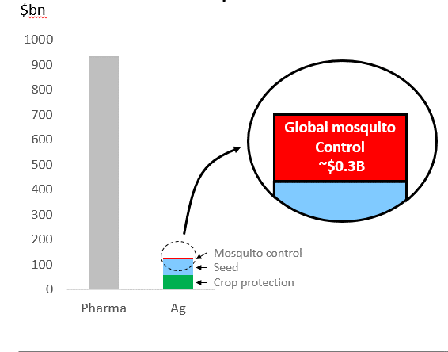
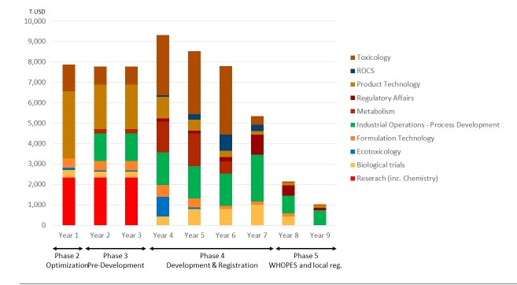
Few chemical options and small market
Small and complex market
Long and costly development timeline for
novel chemistry
Building Partnerships • Creating Solutions • Saving Lives

Slide 14
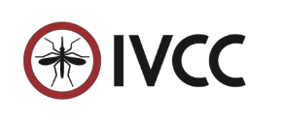
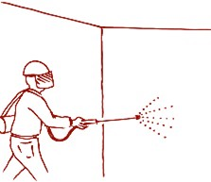








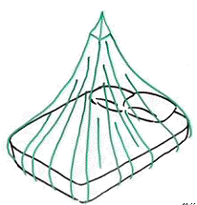














Toolbox design principles: IVM with three tools to manage insecticide resistance
Interpreting GPIRM:
A notional six year insecticide rotation plan with
an IVM program using three insecticidal products
Year:
1 | 2 | 3 | 4 | 5 | 6
IRS: >6 months efficacy,
multiple a.i.s used in subnational rotation
LLIN: 2 a.i.s with different MoA at full efficacious
rates >20 washes. Replaced every 2 or 3 years.
ATSB: >6 months efficacy, rotate every 6
months or multiple a.i.s in each station
ATSB
The principles of the 6 year programme:
No cross-resistance between different insecticide classes either at active site or metabolism
The same insecticide should preferably not be used for IRS and LLIN in the same setting
Long term (>1 year) products require a minimum of full rate mixture of 2 different insecticides
Insecticide rotation is practised to avoid population accumulation of resistance
This IVM strategy calls for the use of between 3 and 10 different classes of insecticide depending on the tools used
14
BMGF February 2019
CONFIDENTIAL: Not for Distribution
Building Partnerships • Creating Solutions • Saving Lives

Slide 15
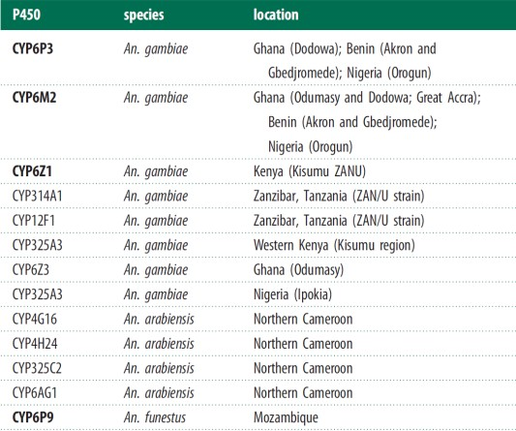
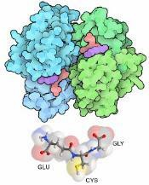
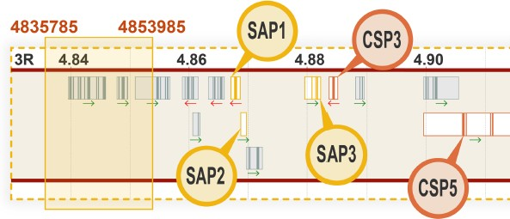
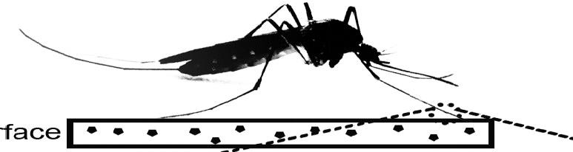
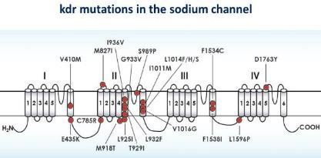
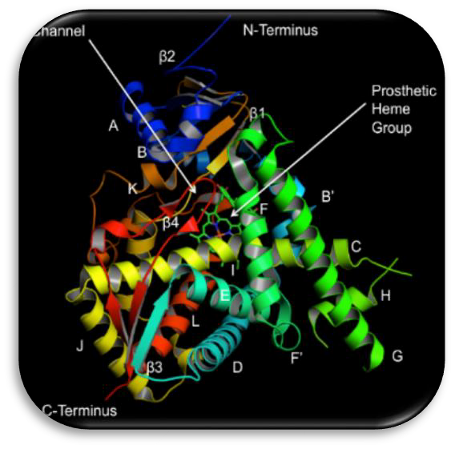
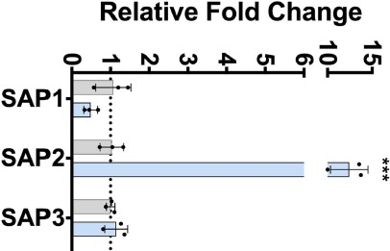
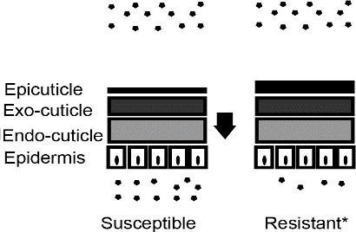
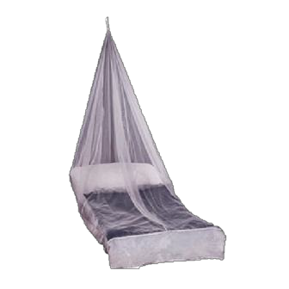

Mosquito resistance mechanisms – target site is just one concern
LITE continually updates resistant strains for testing against new actives
Mosquito resistance is a complex and evolving story
P450s
Metabolic resistance Glutathione S-
transferase
Esterases
Sensory Appendage Proteins (SAP)
Cuticular thickening
Target site resistance
Cuticular hydrocarbon increase/changes in resistant strains
SAP2 upregulated in resistant strains
Behavioural resistance
CHC
Resistant
Susceptible
Resistant
Susceptible
Building Partnerships • Creating Solutions • Saving Lives

Slide 16
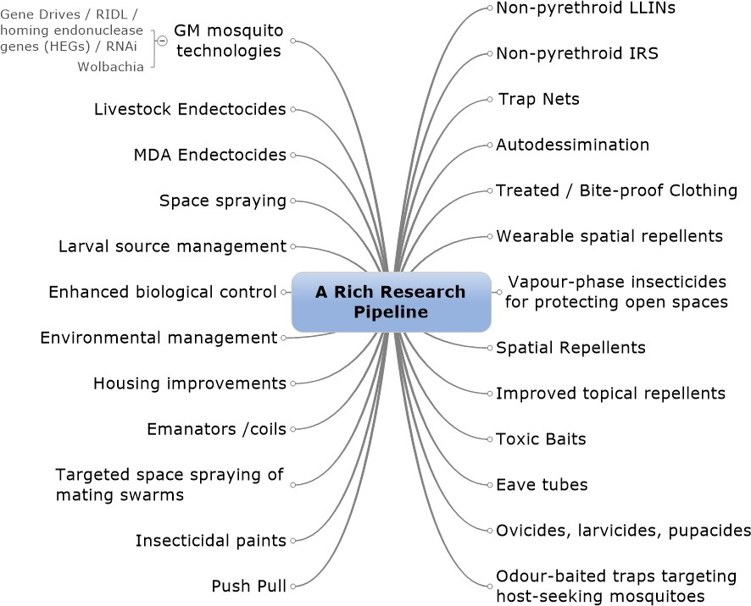

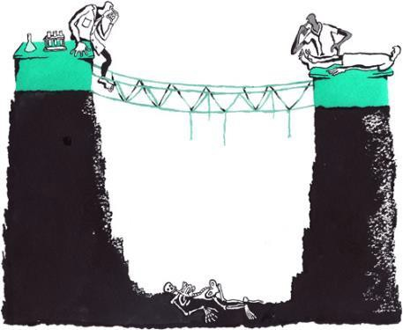
Exploration of vector-control technologies is a rich area of research
The pipeline is rich….but the promise is fragile and high risk
Product Development Valley of Death
Building Partnerships • Creating Solutions • Saving Lives

Slide 17







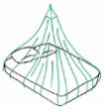



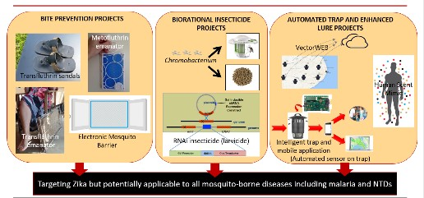



Portfolio evolution through time
2005 2006 2007 2008 2009 2010 2011 2012 2013 2014 2015 2016 2017 2018 2019 2020 2021 2022 2023 2024 >2025
Partnership with manufacturers
Complete
toolbox
Chemical library screening
[4.5M compounds]
Optimization
Pre-development
[9 leads/backups]
Development as LLIRS and LLINs
[4 leads+1 option]
[27 classes]
[IRM]
Novel AIs
Sylando
[LLIRS non-py.]
IVCC
[LLIRS py. based]
[LLIRS non-py.]
inception
[IRS]
[LLIRS Dual AI]
Repurposing
[LLIRS non-py.]
Dual AI nets
[non-py.]
[LLIN Dual AI]
[LLIN]
ATSB
[Outdoor]
‘MIND THE GAP’
Exploration/Proof of Concept/Application technology……
Other?
[Outdoor]
[Outdoor]
[Application tech.]
17
Building Partnerships • Creating Solutions • Saving Lives

Slide 18










Significant IVCC activities to further the public health mission
From Evidence to Policy to Practice…
New Net Design Center
ESACs
(External Scientific Advisory Committees)
Surface Chemistry
Vector Expedited Review Voucher
Application
Technology
Building Partnerships • Creating Solutions • Saving Lives

Slide 19




Capitalize on Sub-Saharan Africa Experience and Portfolio
Focus on priority disease and vector threats
Select focus countries and partners
  Selection of the most promising projects
  Test against local vectors and specific
environment
  Address access and regulatory hurdles
Creation of a toolbox:
Indoor Residual Sprays
Long-Lasting Insecticide Nets ATSB
Bite prevention tools
Other…..
Quick, impactful
wins
Health Security
Product adaptation rather than development
19
Building Partnerships • Creating Solutions • Saving Lives

Slide 20







IVCC Launch Seminal Indo-Pacific Landscape Reports in Hanoi
www.ivcc.com/landscape-studies
Product / Solution Needs (UCSF)
Regulatory Hurdles (JVP)
Access Challenges (FutureBridge)
Building Partnerships • Creating Solutions • Saving Lives

Slide 21


Published in 2019, IVCC commissioned 3 landscape reports which
identified the major challenges related to malaria in the region
Residual malaria in GMS (inc multi-drug resistant parasites)
Lack of surveillance and control tools, and testing facilities
Variable regulatory systems; often sluggish registration times
Outdoor transmission a
challenge
Hard to reach at-risk populations: migrants, forest workers, remote communities
Large, semi-regulated consumer market
Some insecticide resistance in Anopheles; lack of resistance data
Rising malaria cases in PNG
and Solomon Islands
21
Building Partnerships • Creating Solutions • Saving Lives

Slide 22



The landscape reports and regional experts helped identify the 3 key impactful areas of activity to be supported by IPI
Led by UCSF with partners:
Led by PNGIMR/Burnet/JCU
UND, IHI, STPH, CNM, AFRIMS, KU
2. NATNAT
(Newly Adapted Tools and Network Against mosquito borne disease Transmission)
1. Project BITE
(Bite Interruption Towards Elimination)
Cambodia and Thailand
Papua New Guinea
Efficacy and effectiveness of bite prevention tools against malaria (treated clothing; TPs; SRs), delivered by Forest Packs, for forest workers/rangers
Build framework for rapid assessment and adoption of VC tools; PoC testing for efficacy of new IRS, larvicides and SRs against local malaria vectors
Led by Imperial College
Improved forest pack
tools in GMS
Scale up plan for tools
Regional Best Practice
PoC of new tools in PNG
  Scale up plan for tools
Regulatory strengthening
3. Modelling Modelling impact of new vector control tools on
malaria in PNG
in PNG
²S²OPs for product testing
Building Partner
ships • Creating Solutions • Saving Lives

Slide 23





Partnering on IRS with Pilgrim Africa in Uganda
High burden community (>60% infection with qPCR at baseline)
Pyrethroid LLINs only vs 4 spray rounds of Actellic + LLINs
Odds of being found to be positive by qPCR, adjusted for age and
seasonality
LLINs | IRS + LLINs Adjusted Odds Ratio
1 | .36
2018 UMIS: average microscopy prevalence of 3.4% in districts with IRS
2018 UMIS: Similar regions without IRS but with LLINs ranged from 21%
to 29%
https://www.pilgrimafrica.org/our-work/public-health/krmp/

Slide 24








Thank you

