Slide 1
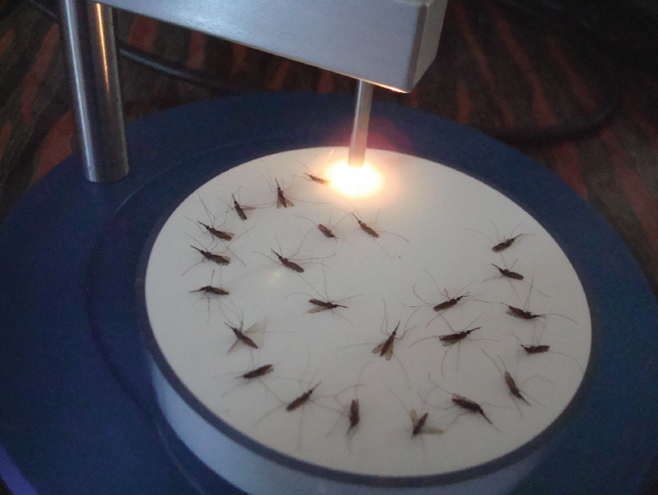
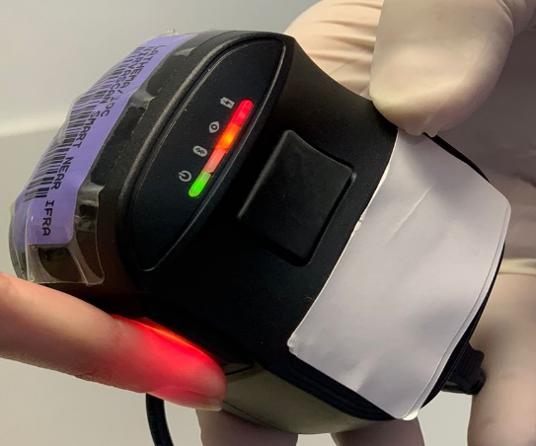
Spectroscopy tools for identification of mosquitoes and diagnosis of malaria
Maggy Lord, PhD
The University of Queensland

Slide 2
WHO Malaria elimination framework 2016-2030
Strengthen vector surveillance
Transform malaria surveillance into a core intervention
Test all individuals with suspected malaria
Quality and timelines for case reporting
Community case detection
3. Universal access to malaria prevention, diagnosis and treatment
4. Understand the intensity of malaria transmission
5. Enhance and optimize vector control

Slide 3
Why vector/parasite surveillance is crucial for malaria control
Transmission hotspots
Species present and their abundance
Infection rates
Survival(age)
Insecticide resistance
Assess change in mosquito behaviour
Identify asymptomatic patients
Our Focus is to develop
Faster/accurate age grading alternatives
More affordable species differentiation methods
Faster and affordable infection detection techniques
Faster detection tools for insecticide resistance
Rapid and non-invasive diagnostic tools for asymptomatic malaria patients

Slide 4

Vector control and surveillance
Vector surveillance is the routine monitoring of mosquito populations to assess the impact
of vector control interventions
Number of female mosquitoes
Transmitting
Not transmitting
Non-Infectious stage
Vector control interventions
Infectious stage
Blood
seeking
EIP (9-12 days)
Age (days)
Modified from Brownstein et al. 2003. J. Invertebr. Pathol. 84: 24-29

Slide 5
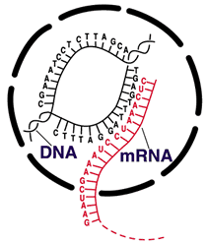
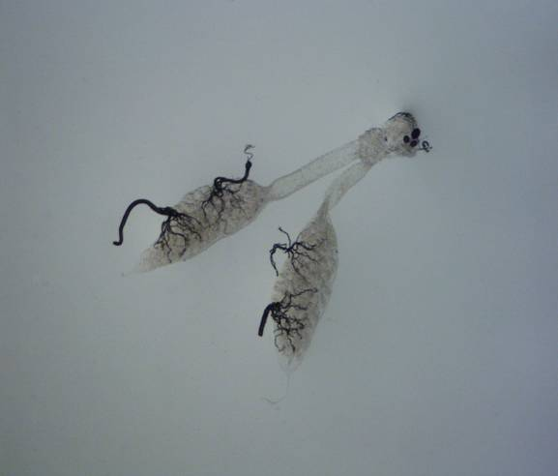

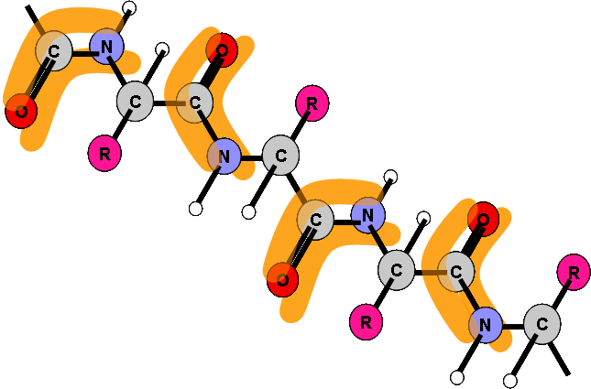
Current state of mosquito surveillance
Ovary dissection
To estimate survival
Molecular techniques
To determine age
Species, infection and insecticide resistance
Cuticular hydrocarbons
To estimate survival
ELISA
To detect infection

Slide 6
Cost and efficiency
Method | Cost | Throughput | Predictable Ages
Ovary dissection | $ | - - - | *Parous, Non-parous
Hydrocarbon Analysis | $$$$ | - | <5, 5-9, >15 days
Transcriptomic | $$$$ | + | Accurately up to 20 days
Protein (ELISA) | $$$ | +++ | >5, 5-9, >10 Under development

Slide 7
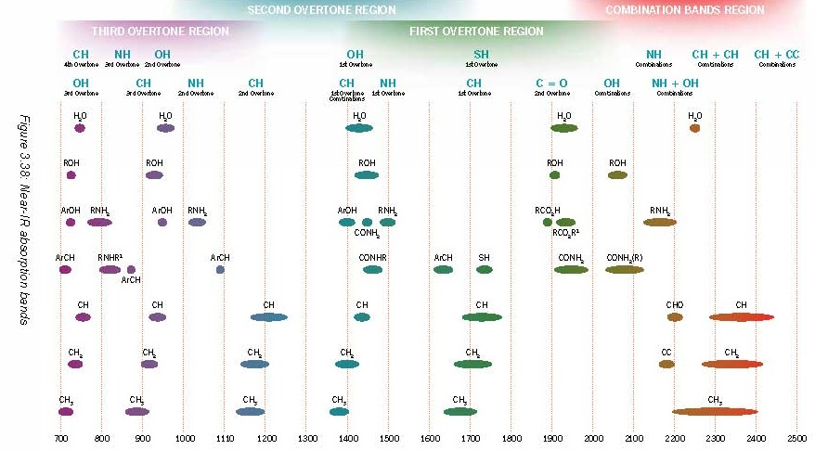
The Near-infrared spectroscopy (NIRS) technique for surveillance of
malaria vectors
Absorbance
Wavelength (nm)
Measures specific frequencies of light absorbed by biological samples

Slide 8
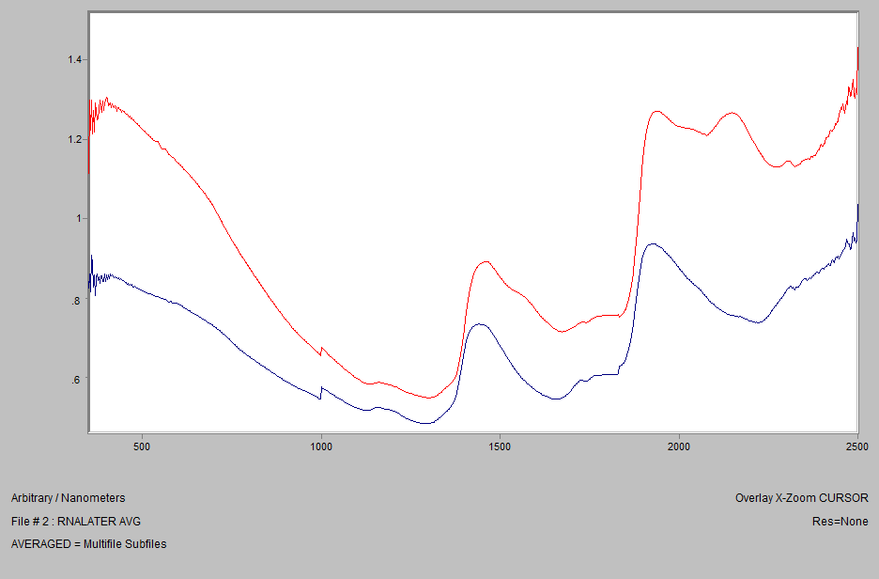
Advantages of NIRS
Non-destructive/simple to use
Does not require reagents
Little sample processing
Takes approx. 15 sec to prepare and collect spectra
Hundreds of samples can be scanned in a day
A spectrum can be analysed for multiple parameters;
Age
Species identification
Infection
At least 35 times faster than existing techniques
Over 50 times cheaper than existing techniques

Slide 9
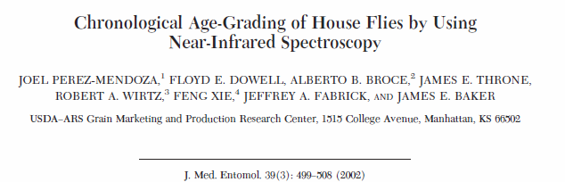
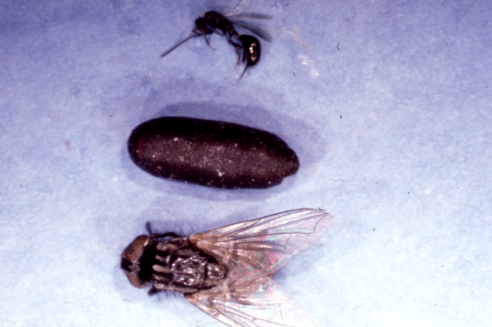
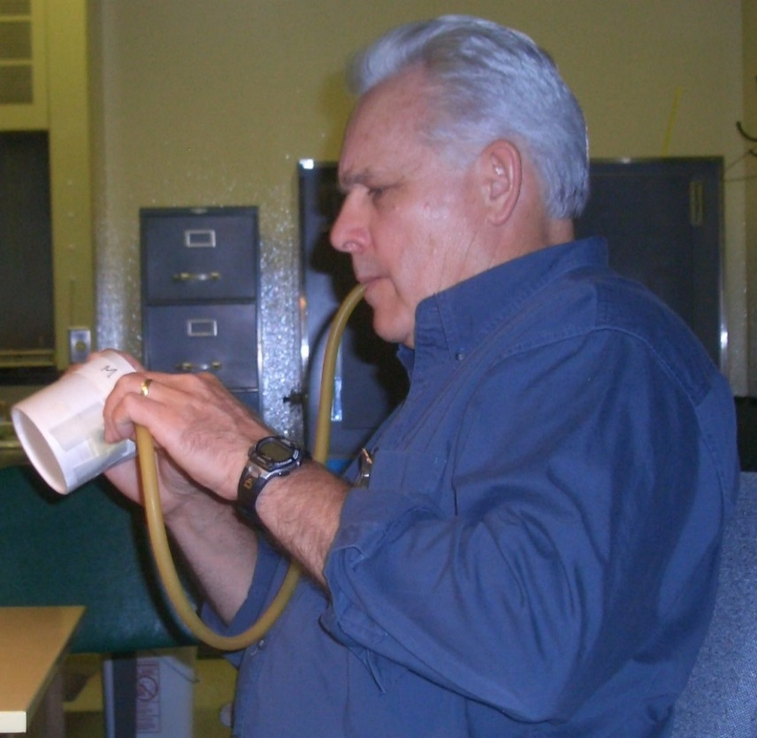
How it started… 2008
Prof. Bob Wirtz, CDC
Prof. Bob Wirtz, Chief Entomologist, Centers for Disease Control, heard our presentation at a meeting “Prof Floyd Dowell”

Slide 10
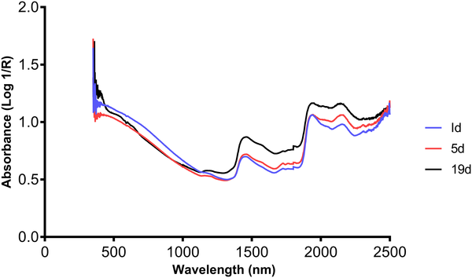
Application of NIRS for surveillance
Anopheles gambiae
Age, species and infection finger printing
Anopheles arabiensis

Slide 11
Overview of past and current work in the NIRS field
Age grading An. gambiae and arabiensis
Species identity of Anopheles gambiae and Anopheles arabiensis in the Lab, semi-field and field
Preservation techniques compatible with NIRS
Whether exposure to insecticides affects prediction accuracy
Detection of Plasmodium parasites in Anopheles
Age grading Aedes aegypti (male and female)
Age grading Aedes albopictus
Detection of Wolbachia in Aedes aegypti
Detection of Zika, Dengue and Chikungunya in Aedes aegypti
Detection of co-infection (Zika and Dengue)
Diagnosis of arboviruses in blood
Diagnosis of malaria in blood and through the skin of mice and humans
Diagnosis of STH (Trichuris, hookworms) and schistosomiasis in blood, mice and faecal samples
Development of smart scanners and smart traps

Slide 12
Age grading An. gambiae and An. arabiensis (Sikulu et al 2010)
Age prediction accuracy into < or ≥ 7 days old
89% for An. arabiensis and
78% for An. gambiae
90% species identification in the semi-field and Field

Slide 13
Age grading fresh vs. preserved, 2011 (Sikulu et al 2011)

Slide 14
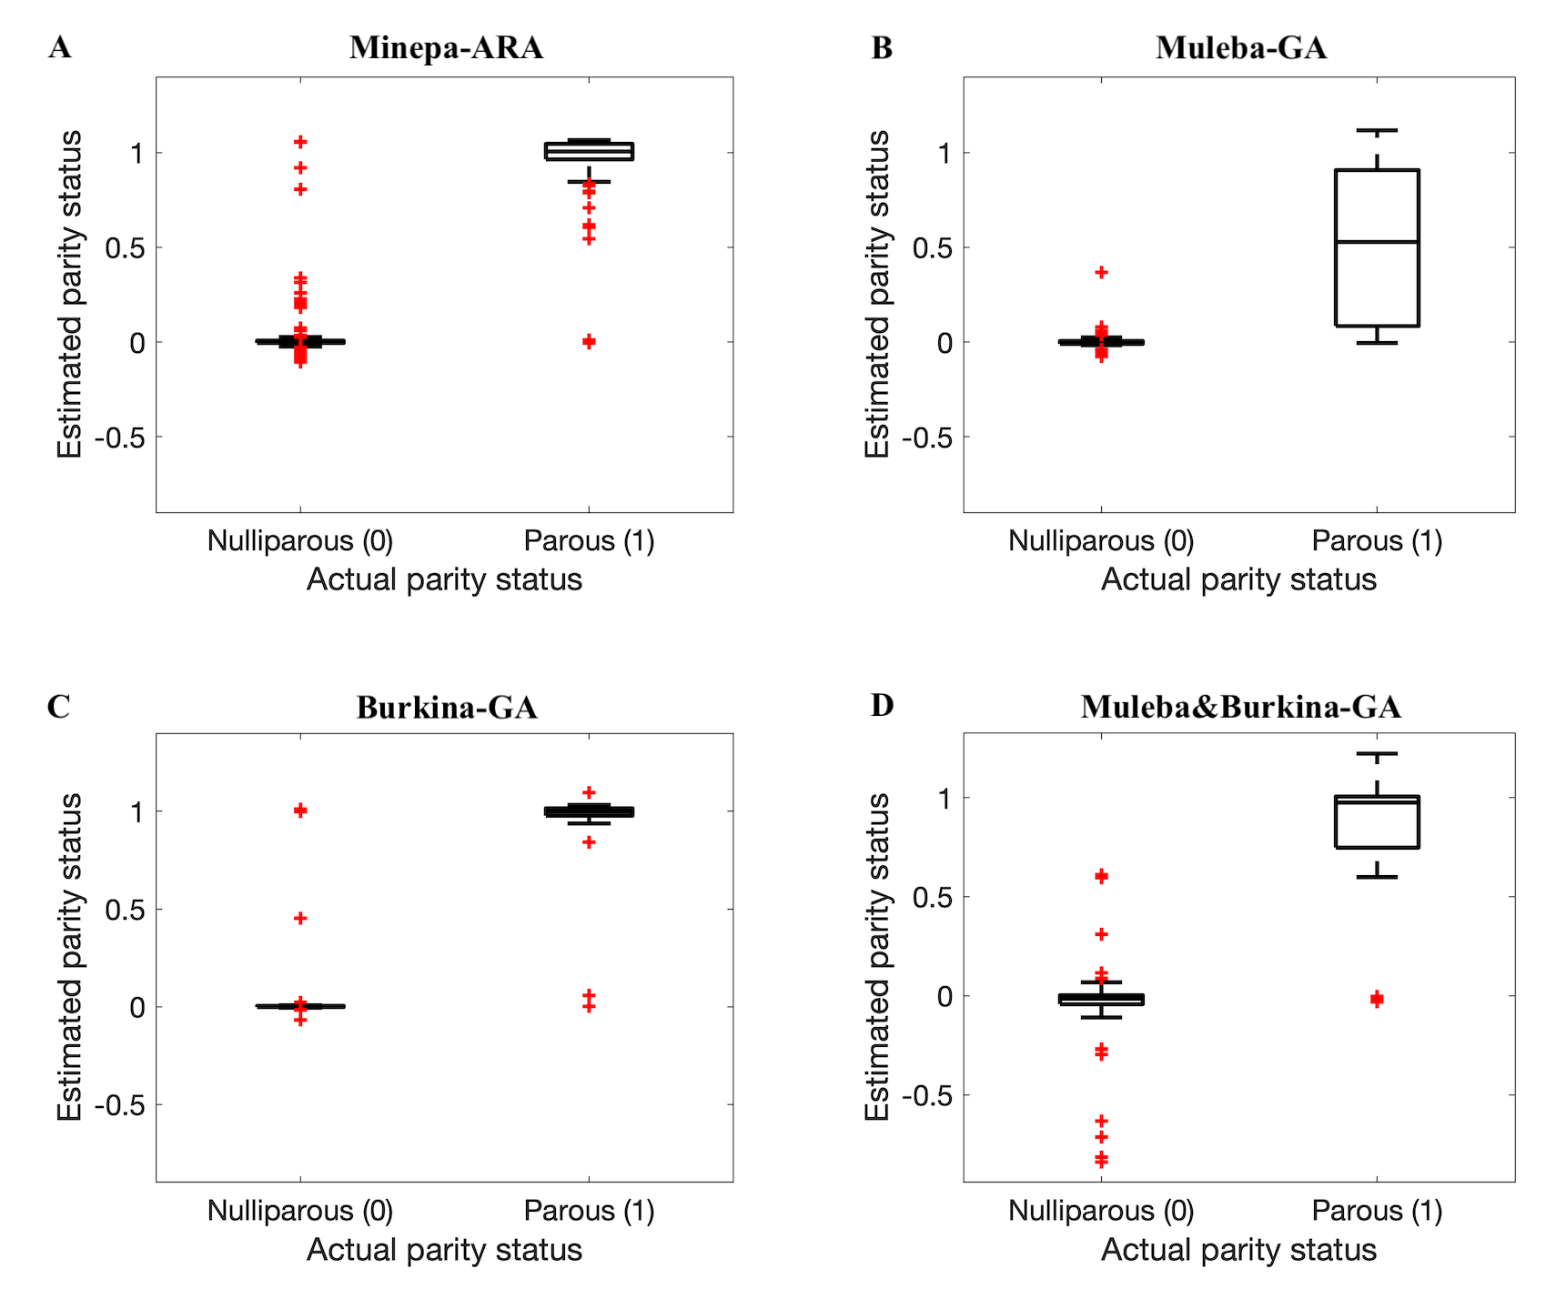
First evidence that NIR can be used in the field to differentiate parous from Nulliparous mosquitoes (Milali et al 2020, PLOS One)
97% accuracy (N=274)
89% accuracy (N=43)
93% accuracy (N=48)
91% accuracy (N=91)

Slide 15
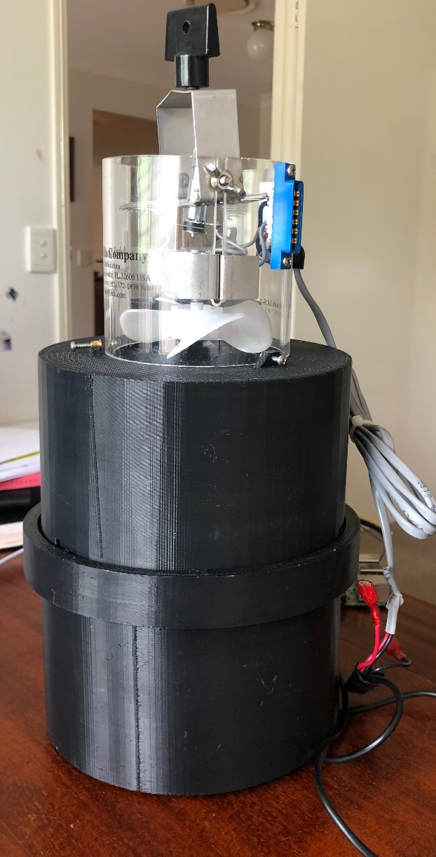
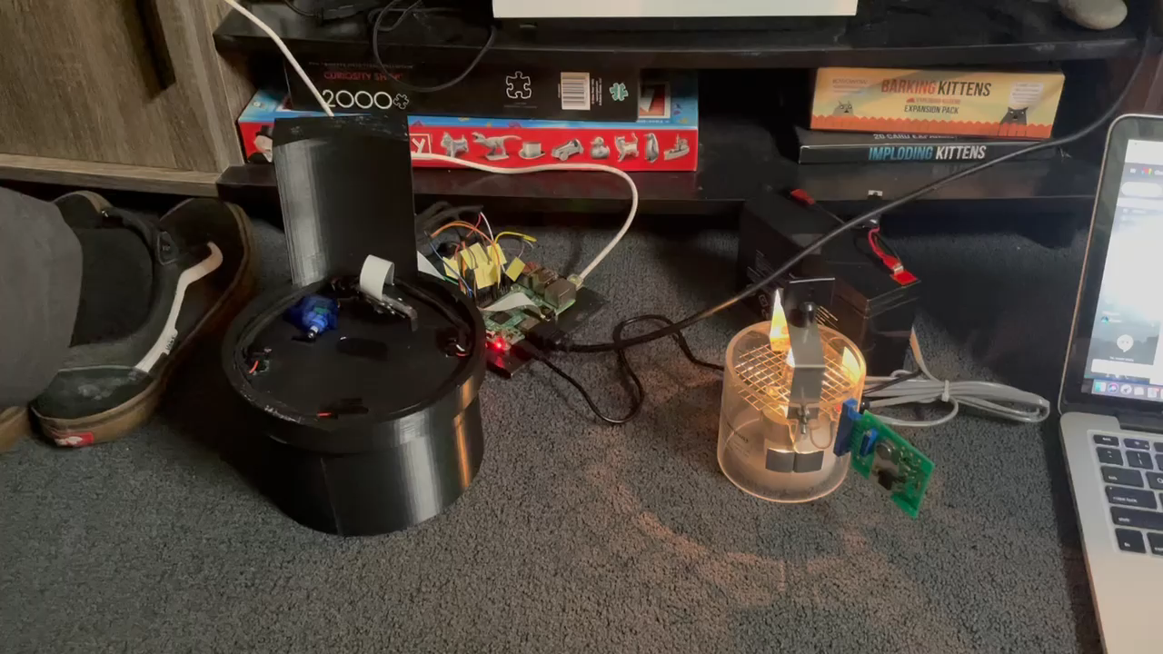
The NIRSID smart Trap

Slide 16
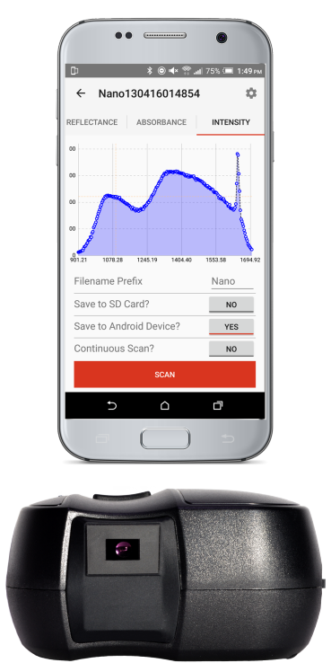
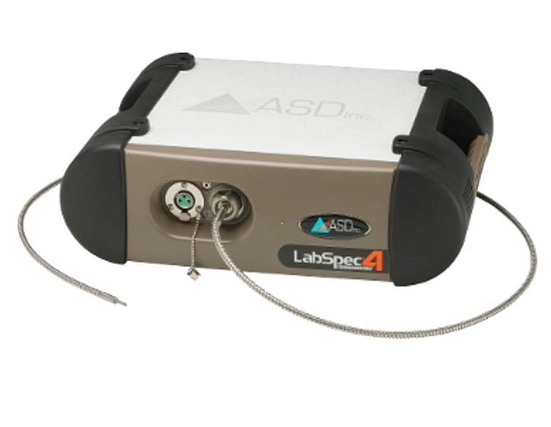
NIRS for non-invasive detection of malaria
To test the capacity of NIRS as a non-invasive detection tool for malaria in the lab using benchtop spectrometers
Test the ability of handheld smart NIR spectrometers to detect malaria
Test the sensitivity of NIRS in detecting low parasitaemia/asymptomatic malaria in the field
Vs.

Slide 17
NIRS for non-invasive detection of malaria (In partnership with ADFMIDI)
Determine the ability of NIRS to detect and quantify Plasmodium parasites through the skin of mice
Mice were assessed with rising parasitaemia from 0- 72 hrs post infection (0-28% parasitaemia)
2. Determine the capacity of NIRS to detect malaria in red blood cells
3. Use machine learning algorithms to develop malaria diagnostic models

Slide 18
Sensitivity of NIRS for detecting infection through the skin of mice
%Par | Scanning blood samples from the tail vein of mice |  | Non-invasive scanning of mice body parts
 | %Sen [N*] | %Spec %[N†] | Sensitivity (%) [N*] |  |  |  | Specificity† (%) [N]
 |  |  | Ear | Foot | Groin | Tail | Ear | Foot | Groin | Tail
≥3% | 95 [38] | 84 [213] | 94[66] | 91 [66] | 92 [66] | 80 [66] | 86 [342] | 87[342] | 79[342] | 82[342]
0.6-2% | 63 [36] | 84 [213] | 71 [48] | 90 [48] | 81 [48] | 62 [48] | 86 [342] | 87[342] | 79[342] | 82[342]
≤0.5% | 46 [38] | 84 [213] | 42 [72] | 59[72] | 65[72] | 53[72] | 86 [342] | 87[342] | 79[342] | 82[342]
Overall | 68 [112] | 84 [213] | 70 [179] | 80 [179] | 82 [179] | 66 [179] | 86 [342] | 87[342] | 79[342] | 82[342]

Slide 19
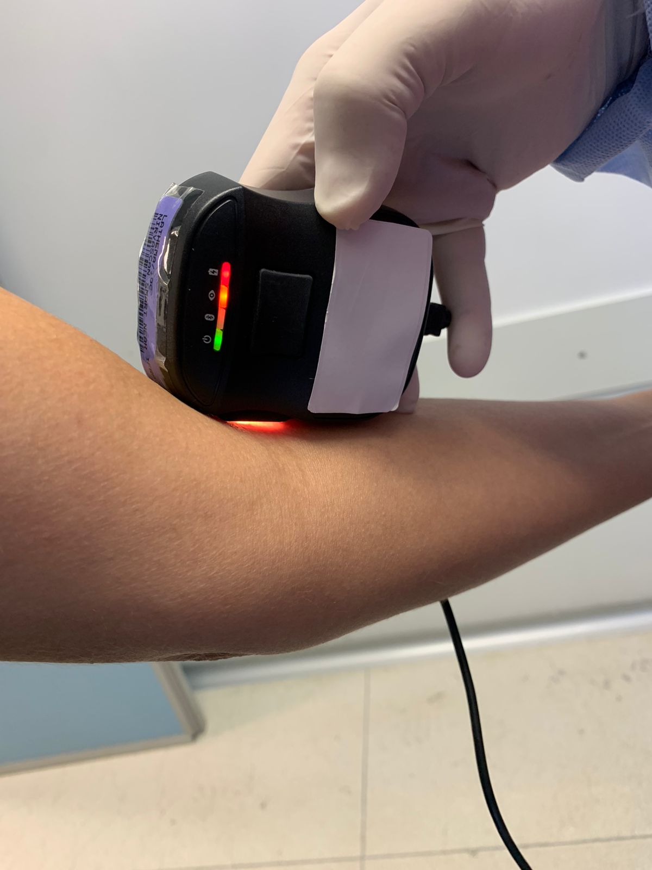
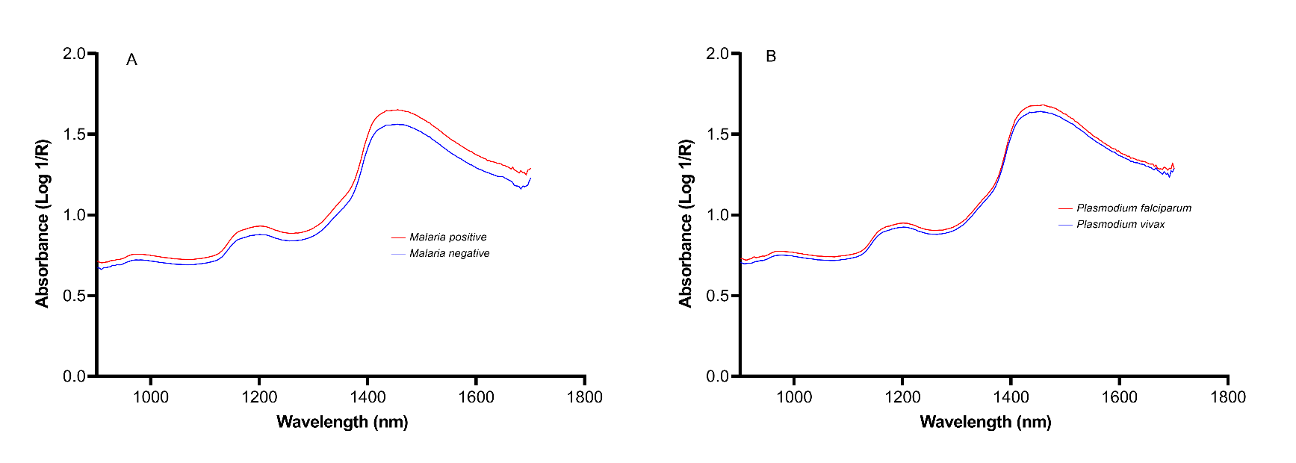
Non-invasive detection of malaria in patients (In partnerhip with Fiocruz, Brazil)
Malaria related peaks identified in human subjects
Plasmodium falciparum peaks
60 subjects scanned
33 malaria negative
27 malaria positive
74% with low parasitaemia

Slide 20
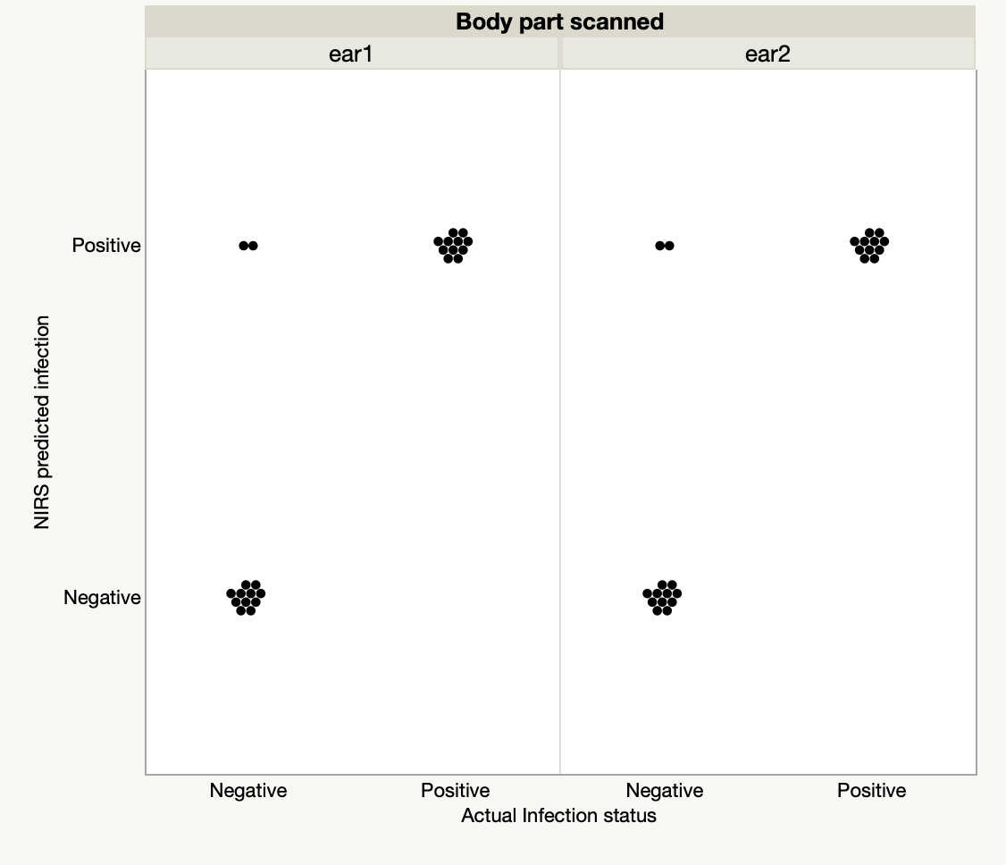
Sensitivity for detecting malaria was best when ears were scanned
100% sensitivity
85% specificity
92% accuracy

Slide 21
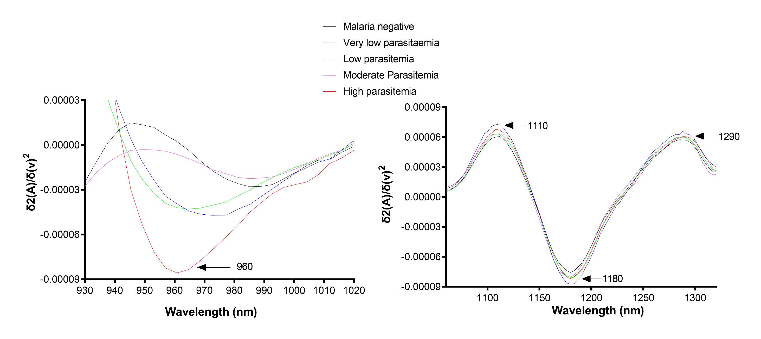
Infrared peaks were observed to scale with patient parasitaemia

Slide 22
Where we are now
Validating infrared tools for surveillance of malaria mosquitoes
Age grading
Species identity
Infection detection
Testing the handheld infrared spectrometers in the field with partners
Sensitivity/specificity
Identification of asymptomatic malaria carriers
Development of Smart traps
Can collect mosquitoes
Can be remotely operated
Can identify age, species and infection

Slide 23













Acknowledgements
Funding
Research Partners

